Slide 1
Train the Trainer Workshop
Train Malta, July 2018
Sarah Morgan
sarahm@ebi.ac.uk
www.ebi.ac.uk/training

Slide 2
Aim of course
To provide new trainers with guidance and tips for developing and delivering training in bioinformatics, exploring learners motivations and needs, examining the requirements for a successful course and acquiring (and applying!) appropriate feedback.
The workshop will:
  provide guidance on general training techniques and appropriate use of methods based on learner needs, including some general do’s and do not’s for successful training
  provide a framework for successful curriculum design and further development, to enable trainers to build training appropriate to their learner’s needs

Slide 3
Overview of Day - Principles of good training
  What makes good and bad training?
  What makes a good trainer?
  How (and why) do people learn?
  Designing a training session - learning aims and objectives, developing training materials
  Delivering a training session – engaging and motivating your learners
  Feedback - how to get it, what to do with it, how to further improve your practice
  Final discussion and summary

Slide 4
About you….
What is your prior experience of delivering teaching / training?
What are your expectations for this workshop?
  Please write your expectations on a post-it note, we will revisit them at the end of the day.

Slide 5
Session 1: Good vs bad training and trainers

Slide 6
Training you have been involved in….
What makes a good training session ?
What makes a bad training session ?
    Think of an example of each that you have participated in and list your thoughts…
Notes:
Run as a group activity - small groups eg 4 per group at most
Two sets of post its per group - “Good” and “bad”
Bring all groups post-its together and sort for “consensus”
Brief discussion as whole group on the good and bad points raised.

Slide 7
What makes a good trainer ?
Knowledge of subject
Clear aims for session outcomes
Confidence in delivery
Appropriate delivery
Listens to trainees
Flexible – can change pace / depth if required
Approachable
Engaging
Notes:
Throw question out to group - reiterates the findings from the good and bad examples;
What in their opinion makes a good trainer (list is hidden, animated to show full list once some suggestions have been provided by the group)

Slide 8
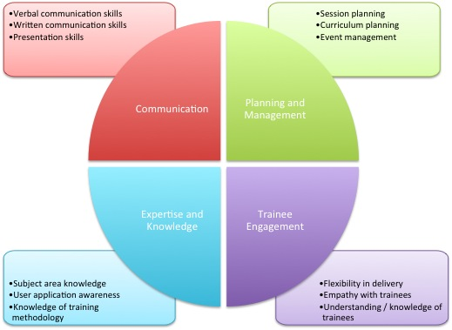
Goblet TTT matrix
Notes:
This matrix developed by goblet TTT taskforces - aims to provide an overview of the major skills required to be a good trainer; note that not all trainers will have all skills - that is note the point! This can be circulated in advance so they can reflect on their current skills and how they fit with this matrix. A more detailed version with explanation can be provided during the session.

Slide 9
Session 2: How do people learn?

Slide 10


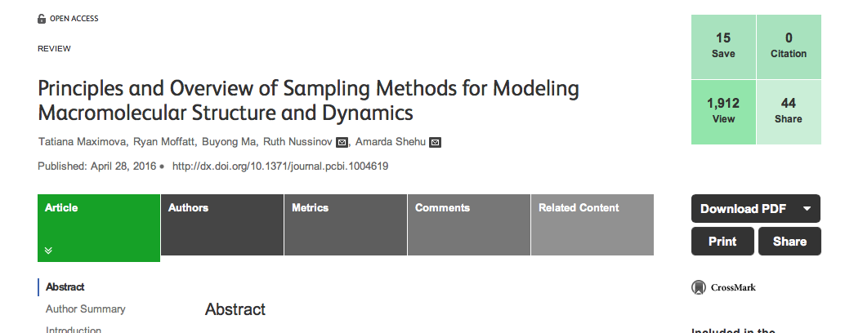


How do you approach learning new things?
Notes:
Google, lit search, experiment, textbook, online course, youtube,”have a go”

Slide 11
Experiential learning: Kolb’s cycle
Kolb learning cycle :
Concrete
experience
Active
experimentation
Reflective
observation
Abstract
conceptualisation
Notes:
Kolb learning cycle - from 1984
Four stage cycle - internal cognitive processing of learner.
Don’t worry about going into too much detail here - will find reference

Slide 12
Kolb’s cycle in detail
Concrete experience – be involved in a new experience
Reflective observation – reflect on your experiences, potentially with feedback from others
Abstract conceptualisation – form and reform your ideas, integrate into theory
Active experimentation – make decisions and problem solve
Notes:
Must remember that learners already have some knowledge, so building upon what they already have in their mind.

Slide 13
Its not just the how…it’s the why!
Consider a time when you were in a learning situation….
  What was the reason behind the learning? Was it a completely new topic?
  What method did you use to learn?
  What was your approach to the learning? How did you organise yourself?
  How did you feel as you were learning?
  What were the major challenges you faced?
  Did you ultimately achieve your learning goal?
Notes:
In pairs initially, get them to think and discuss – the other person should capture brief answers to the above questions. Compare notes then compare the class; highlight the whole class is like this !

Slide 14
7 factors for successful learning (Phil Race)
  Wanting to learn
  Needing to learn
  Learning by doing
  Making sense of it
  Learning from feedback
  Verbalising
  Assessing
These all merge together!

Slide 15
Session 3 : Designing and delivering your training

Slide 16
Designing your training
Where would you start?
  What has been your approach to designing training?
  What information do you need to know?
Notes:
5 minute group discussion and report back

Slide 17
Target audience
This may or may not be your choice !
Consider what background knowledge the trainees may have, what they are currently doing.
At this point may want to start to think about pre-requisite knowledge
  Eg Undergraduate level biology

Slide 18
Session aim
What is it that you are trying to provide through this session? What subject matter is to be covered?
  How does this fit with the overall course aim (if applicable)
May be to teach people a particular method of analysis, or to introduce people to a new resource.
A clear aim will help when setting curriculum in more detail.
Leads into Learning Outcomes
  What do you want your trainees to be able to do at the end?

Slide 19
Learning outcomes
Should be SMART
  Specific
  Measurable
  Achievable
  Realistic
  Time-limited
What ?
By trainee / trainer or both ?
Is it possible in this context ?
Can we really train them to do this ?
In what time ?
Notes:
Ask what they know about learning objectives - if anything!

Slide 20
Levels of learning – Blooms taxonomy
5 Evaluation
6 Synthesis
4 Analysis
3 Application
2 Comprehension
1 Knowledge
Notes:
Depth of learning you want them to achieve - knowledge is the “surface”; synthesis is the deepest level

Slide 21
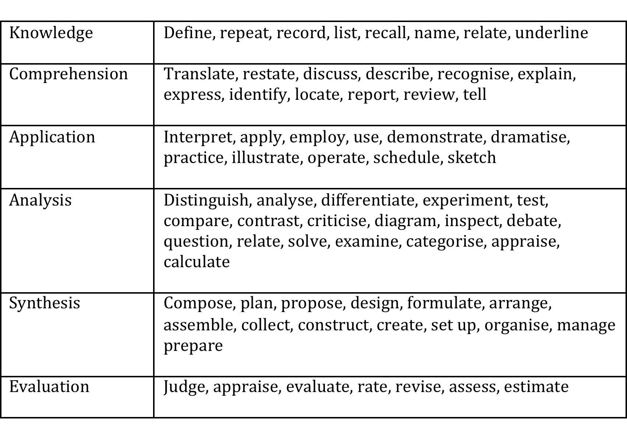
From taxonomy to verbs…
Notes:
LO activity - in small groups, define an aim and learning objectives for a topic of their choice; 10 minutes discussion; feedback to whole group for comment.

Slide 22
Curriculum planning
No one set way of doing this – but if LO’s are set, then expand from these
  What are the major themes which can be identified under your major course topic?
  Which of these will you cover (can you cover all?)
  Will the trainees need some pre-knowledge?
  Need to consider depth of learning
  Think about balance of practice and theory
Notes:
Which can you cover - time and resources?

Slide 23
Learning activities
Need to keep people motivated, actively learning, engaged…….
Remember!!
  People can only concentrate for short periods – often 15 – 20 minutes at most, before it drops
Notes:
Death by powerpoint comment !

Slide 24
Most people learn……
  10% of what they read
  20% of what they hear
  30% of what they see
  50% of what they see and hear
  70% of what they talk over with others
  80% of what they use and do in real life
  95% of what they teach someone else

Slide 25
Learning “activities”
What forms of learning activity can you use? Come up with a list of as many as you can think of!
  How active and engaging are they?
  How do they help in ensuring trainees continue to learn?
Notes:
Small groups as before, but use different groupings
Post-its, one method per post-it
Group them together and discuss as a whole group
On-course learning methods site

Slide 26
Developing materials
How do you build a new set of materials?
  Consider setting up a new session which requires both tutorial and practical elements.
Notes:
Small group discussion - How would they approach this
What challenges faced in doing so previously.
- Discussion aims, LOs, pre-requisite info, level of detail needed, other useful reference points extra reading etc.

Slide 27
Developing materials (2)
Do you always need to develop from new?
  Where can you find materials - for use or inspiration?
  Can materials easily be re-used?
Notes:
Small group discussions.
Discussion on where materials can be found - eg colleagues, GOBLET, other sources?
Discussion about material descriptions / annotation for re-use
Challenges in re-using - could someone else use your material? How can you describe your materials for re-use?

Slide 28
Delivering training
You have your trainees ready to go, content and materials developed….what else do you need to consider?
  Resources required to deliver the course – do you have them all?
    Consider writing a trainer checklist
  Setting expectations from the outset; what you will cover, how you are going to run the session
    Trainees then know what to expect and how to get the most out of your session
  BREAKS!!! They are needed…..
  Time for discussion

Slide 29
Assessing that learning is happening…
Teaching and learning do not necessarily happen at the same time….
  Short training courses do not lend themselves to formal assessments at the end, but how can you assess that your learners are taking steps forward?
    Quizzes
    Discussions
    Q&A sessions
    Short topic overviews delivered by participants
    Projects
    Problem solving

Slide 30
Session 4: Feedback

Slide 31
Whilst running a session - real-time feedback
Do keep an eye on your “audience”
  Watch for signs that they don’t understand, or concentration is lapsing
Try and be flexible – adapting your session to suit the group as you go if possible
  How can you assess where your trainees are during your session /course?
Practicals – can be useful to have someone at the back of the room !
Notes:
Assessing trainee progress - small discussion; methods for keeping track as you go through your session eg instant feedback, 5 fingers, software carpentry post-its, electronic polls, quizzes

Slide 32
Reflective practice
After you have completed a session:
  Think about what worked well and what you were not happy with
  Helps you when planning future sessions, whether the same or a different one
  Don’t be too negative – remember groups vary (do think about the environment etc)
  Where does you feedback come from?
    Self, the room, colleagues and end of course survey

Slide 33
Post-course collection of feedback
Feedback from trainees can be very useful
  Keep surveys short
  Think about your reasons for collecting the information and what you need to collect
  Mixture of closed and open questions
  Think about who will have access to the results – do you need to moderate?
You should always review your feedback along with your own reflections
Notes:
Discussion - what might you ask and how would you use it?

Slide 34
Final discussion

Slide 35
Two questions…
Have your initial expectations been met?
What one thing have you learned that you were not expecting?

Slide 36
Final activity……
Over the next week….
  Think about what you are taking away from today’s session
  What one thing did you learn that was different / new / exciting / unexpected?
  What are you going to do differently next time you train?
  Any other comments….
  Email me – sarahm@ebi.ac.uk

Slide 37
The end

Slide 38
Limitations / issues for Bioinformatics training
Fast changing subject, tools change quickly
  Difficult to use a traditional training approach “click here”
  Need to provide understanding of how tools work, and general idea of what is happening, so if a tool changes, trainees can still use it
Example datasets and appropriate exercises
  Either difficult to get datasets, or need to use cut down sets, so not quite so true to life – teaching concepts, not full practical “how to”

Slide 39
Planning the course
Scientific and “social” elements
  Scientific – in what order will you deliver the various elements of the course content
  Social – coffee and lunch breaks, opportunities for networking
How long do you have to deliver the course ?
  How long should your day be ?
Theory vs practice
  Even in a very practical course, theoretical explanation session are helpful for scene setting

Slide 40
Commonly used sessions
Course welcome and introduction
  Welcome your trainees, give any H+S details etc
  Intro to course, aims and expectations
Start of day
  Brief intro of what is to come, can check everyone is in, all happy
End of day
  Quick recap, again check everyone is ok, good time for discussion
Final wrap-up session and feedback collection

Slide 41
Lecture – style sessions
Death by powerpoint is common !
  Try to make slides more interesting if possible
  Don’t necessarily put everything on the slide you are going to say – avoids you reading off your slides!
  Don’t overfill your slides and use at least a 20 point font
  Build time in for questions, discussions…..

Slide 42
Practical sessions
Practical handbooks important – guided exercises to follow
  Can start with a demonstration, then into the guided exercise
  Remember not everyone will necessarily go at the same pace
    Extra time in programme for people to finish if they wish– eg lunchtimes
    Have some extra exercises eg problems to solve, for those who finish
Can be difficult deciding how much time to give
Having extra demonstrators in the room to answer queries is very helpful

Slide 43
Group problem solving
Can be a good way of getting people talking, can also be a useful way of ascertaining how much people know
  Eg Workflow exercise – what are the steps taken in a metagenomic workflow, potential limiting points in this etc
  At the beginning can be useful to get people into the mindset, and help you set the scene for the course
  You can refer back to this session at different points in the course, helping reinforce ideas
Especially useful in sessions where you have a high number of novices in the field

Slide 44
Course descriptors and advertising
Keep course descriptors concise, but consider what information people will use to choose a course.
  List points to include?
Make sure it is a true representation of what you will cover, so trainee expectations can be managed / met
Advertise everywhere you can!

Slide 45
Applications
Methods of application can vary – e.g. CV and supporting letters or completion of online form
You need to decide on your selection criteria
  Be transparent, so if someone queries you, they can be answered.
  Make sure that you can get the information you need for selection from the information you have requested.
May decide on a selection committee - more than one person to review all applicants.

