Slide 1

FOSTER-xR
Blended Mobility of Higher Education Students at MEVGAL
Yuchen Li

Slide 2
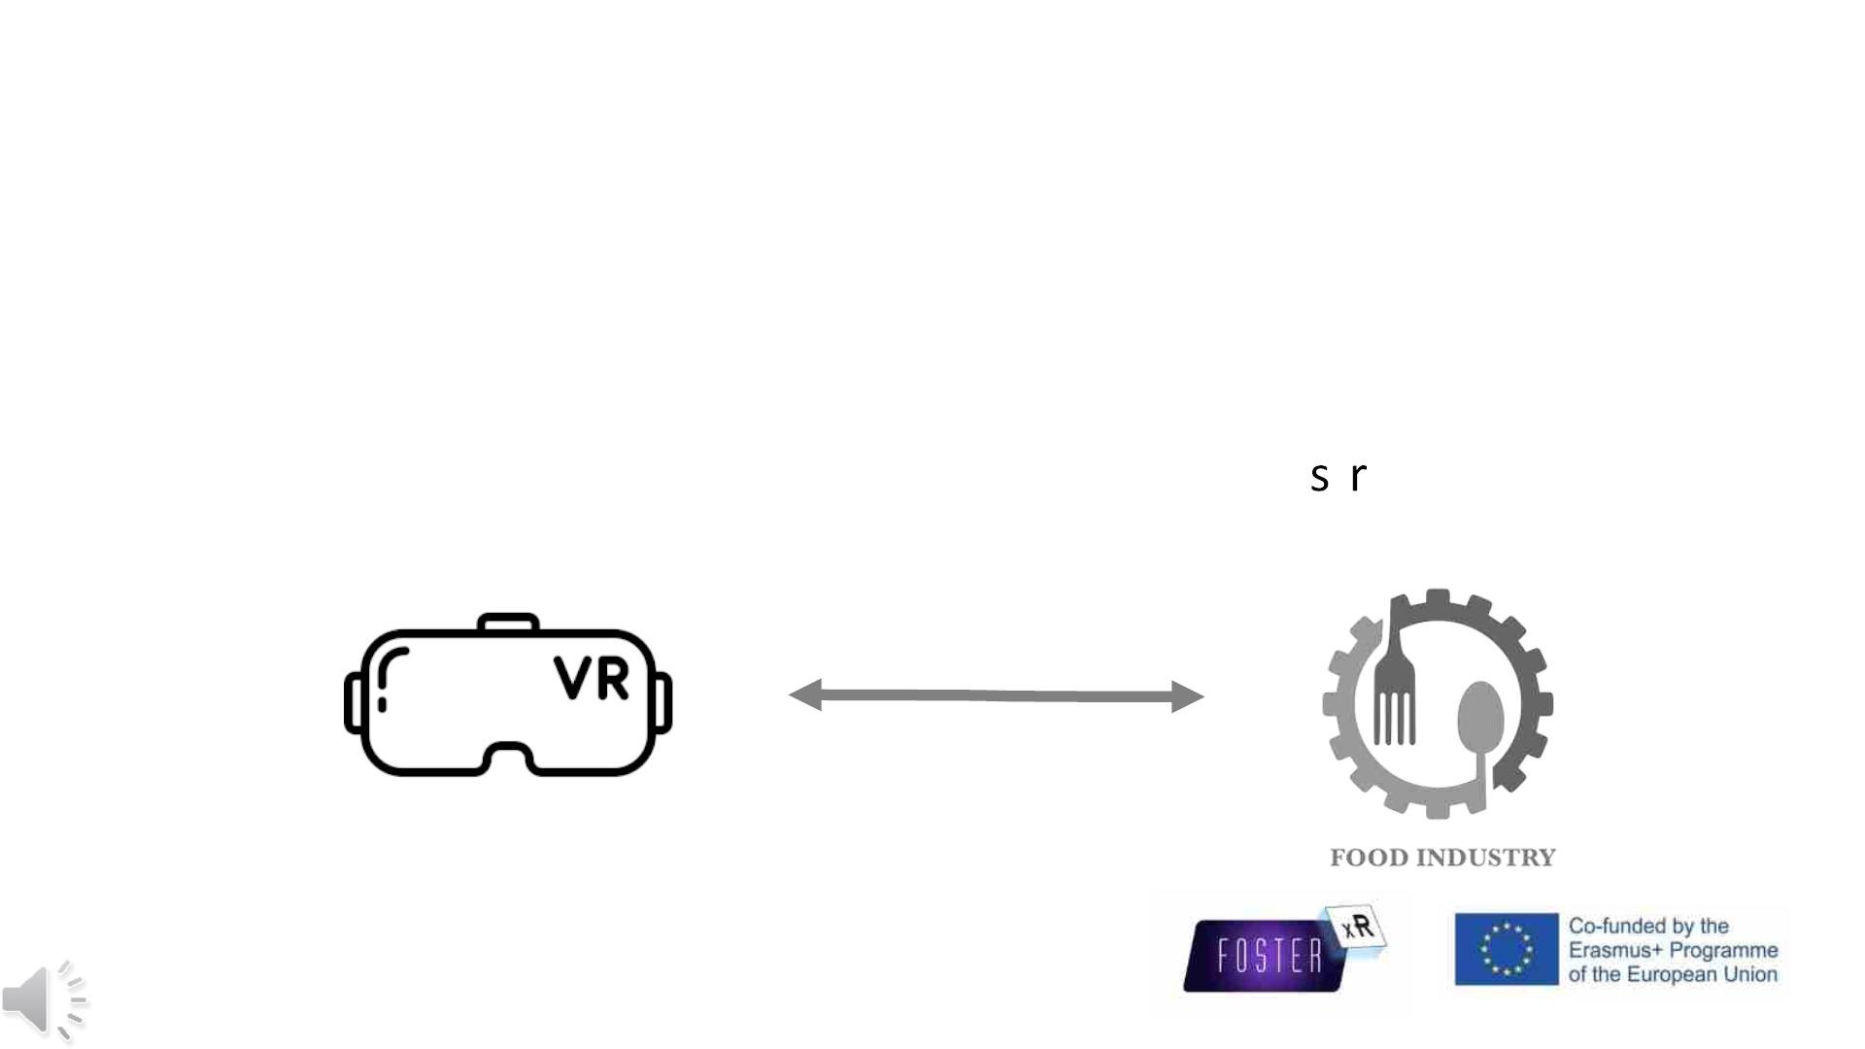
Introduction
Scope of the work
• Design and piloting of an xR tool in the food indu t y

Slide 3

Introduction
MEVGAL S.A.
University of Macedonia

Slide 4
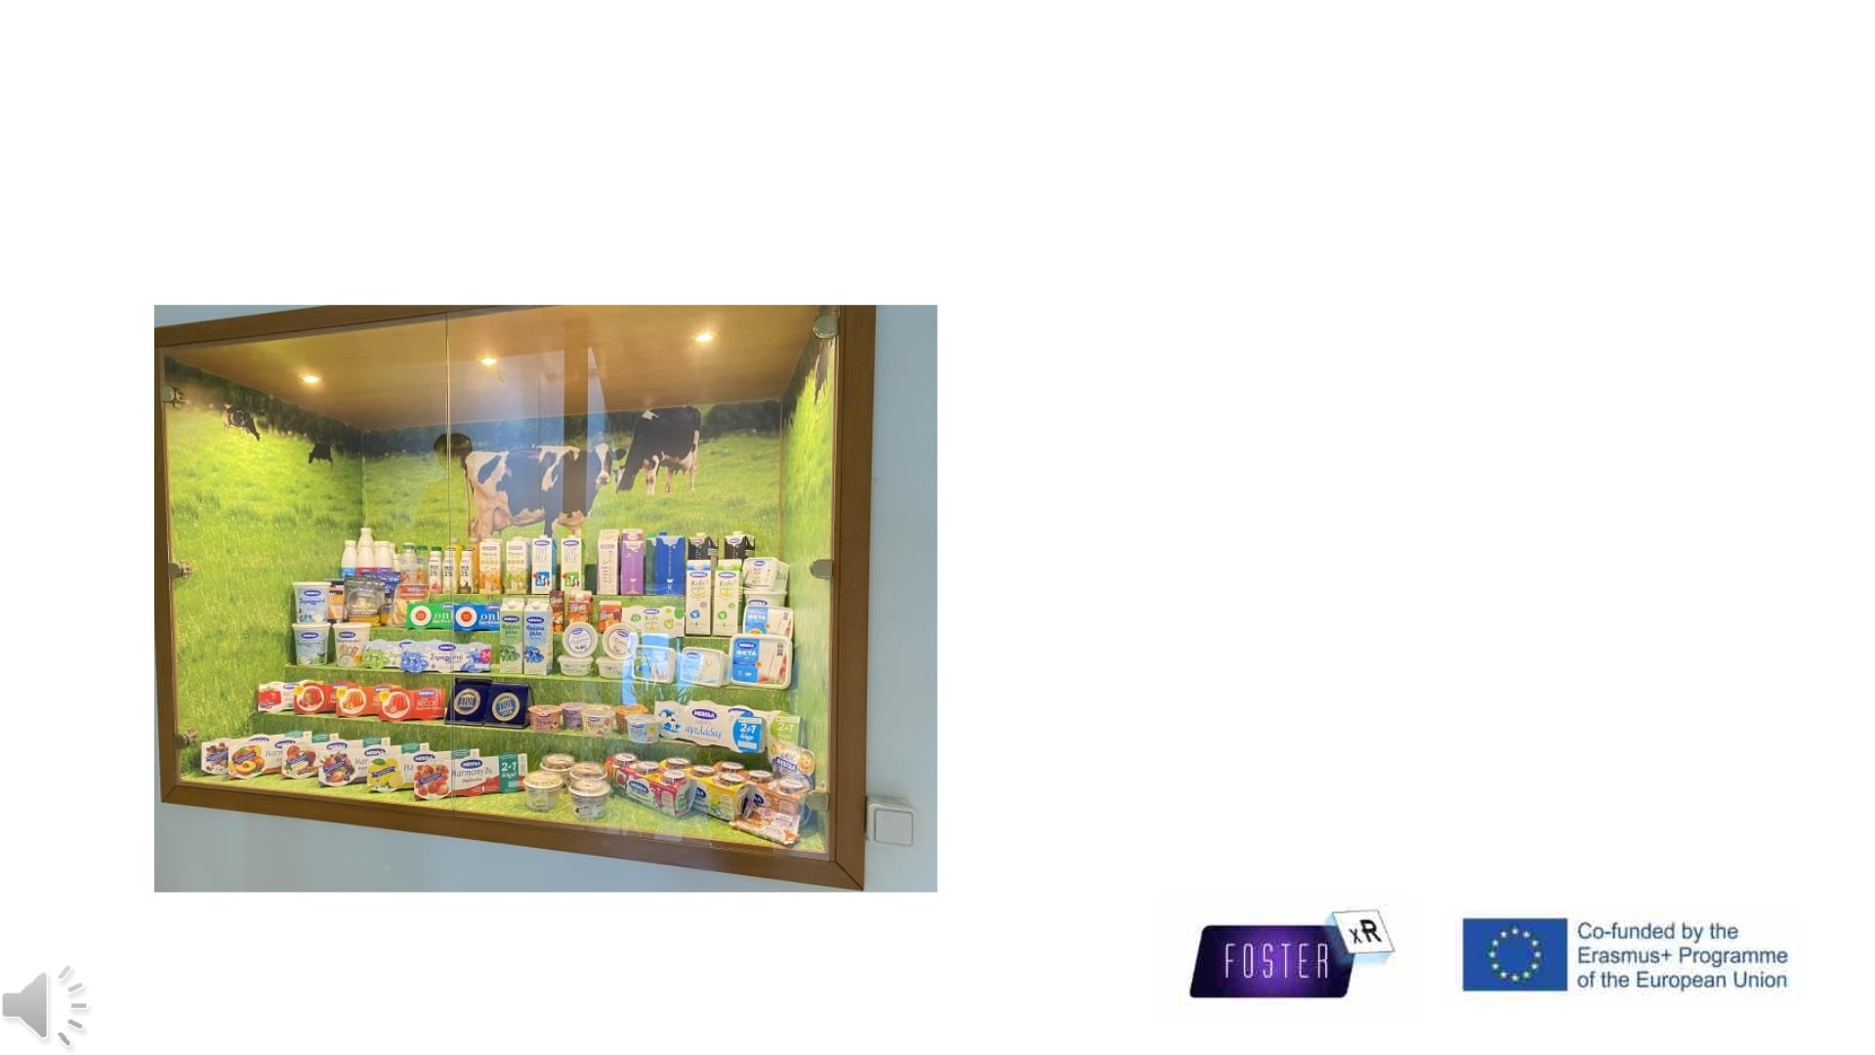
Introduction
MEVGAL
Four main products:
• Fresh pasteurised milk
• Traditional Yogurt
• Greek Yogurt
• Feta Cheese

Slide 5
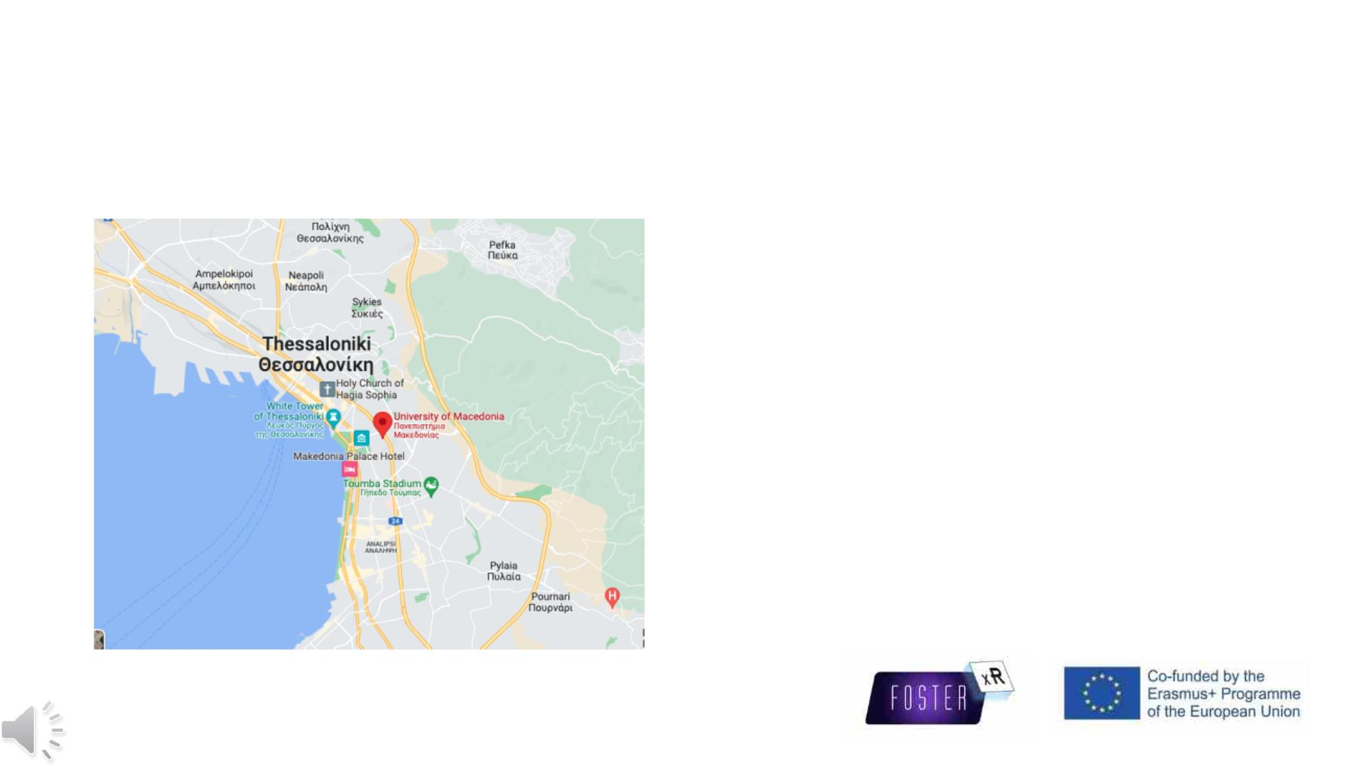
Introduction
UoM Department of Applied Informatics
Two Introductory specialisations:
• Computer Science and Technology
• Information Systems

Slide 6
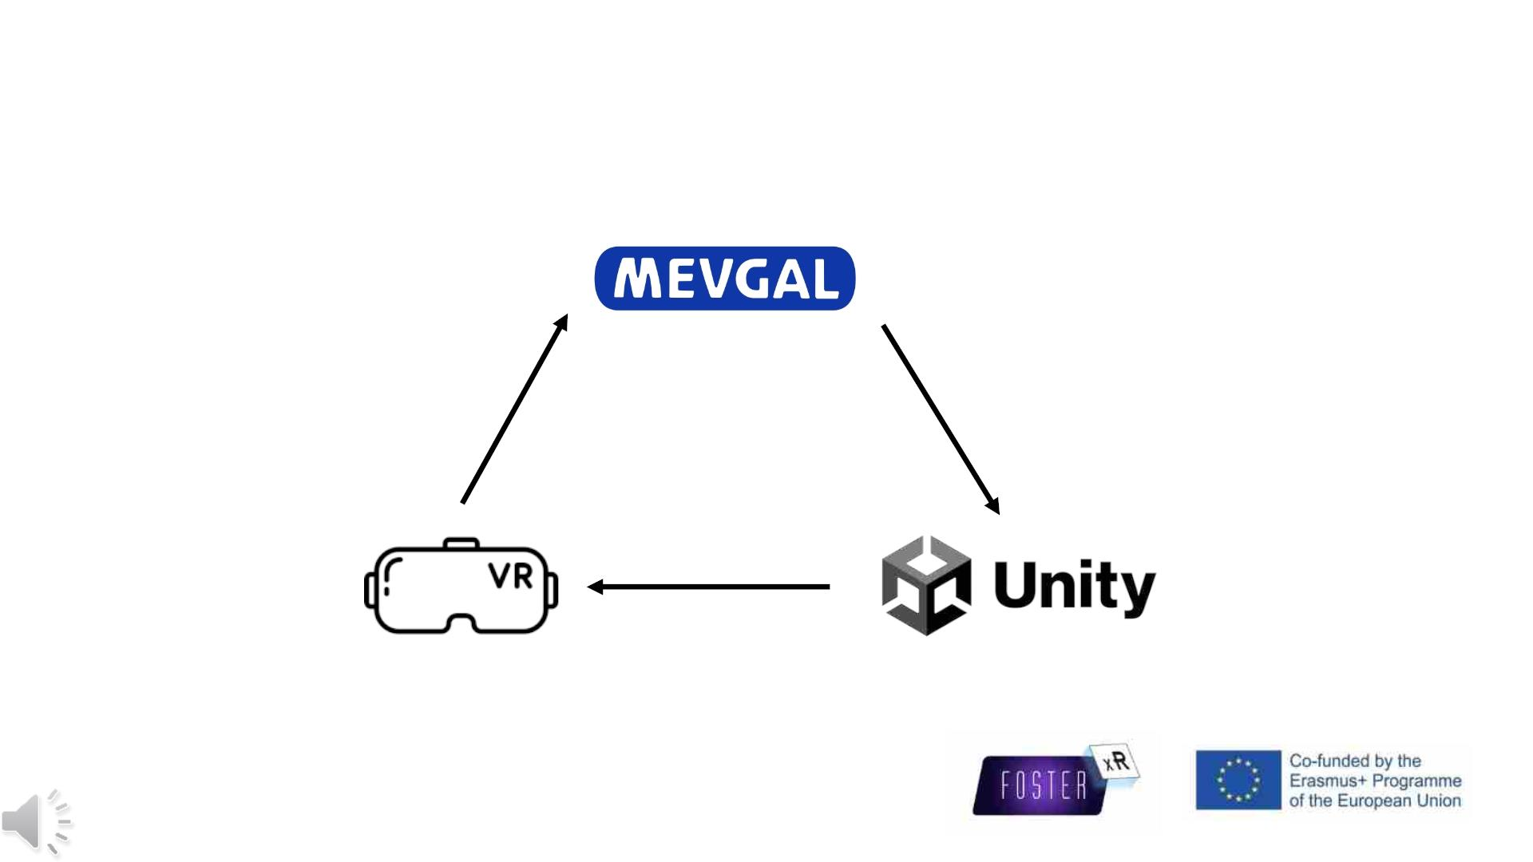
Methodology
Applications
Modelling
Export
Optimisation

Slide 7
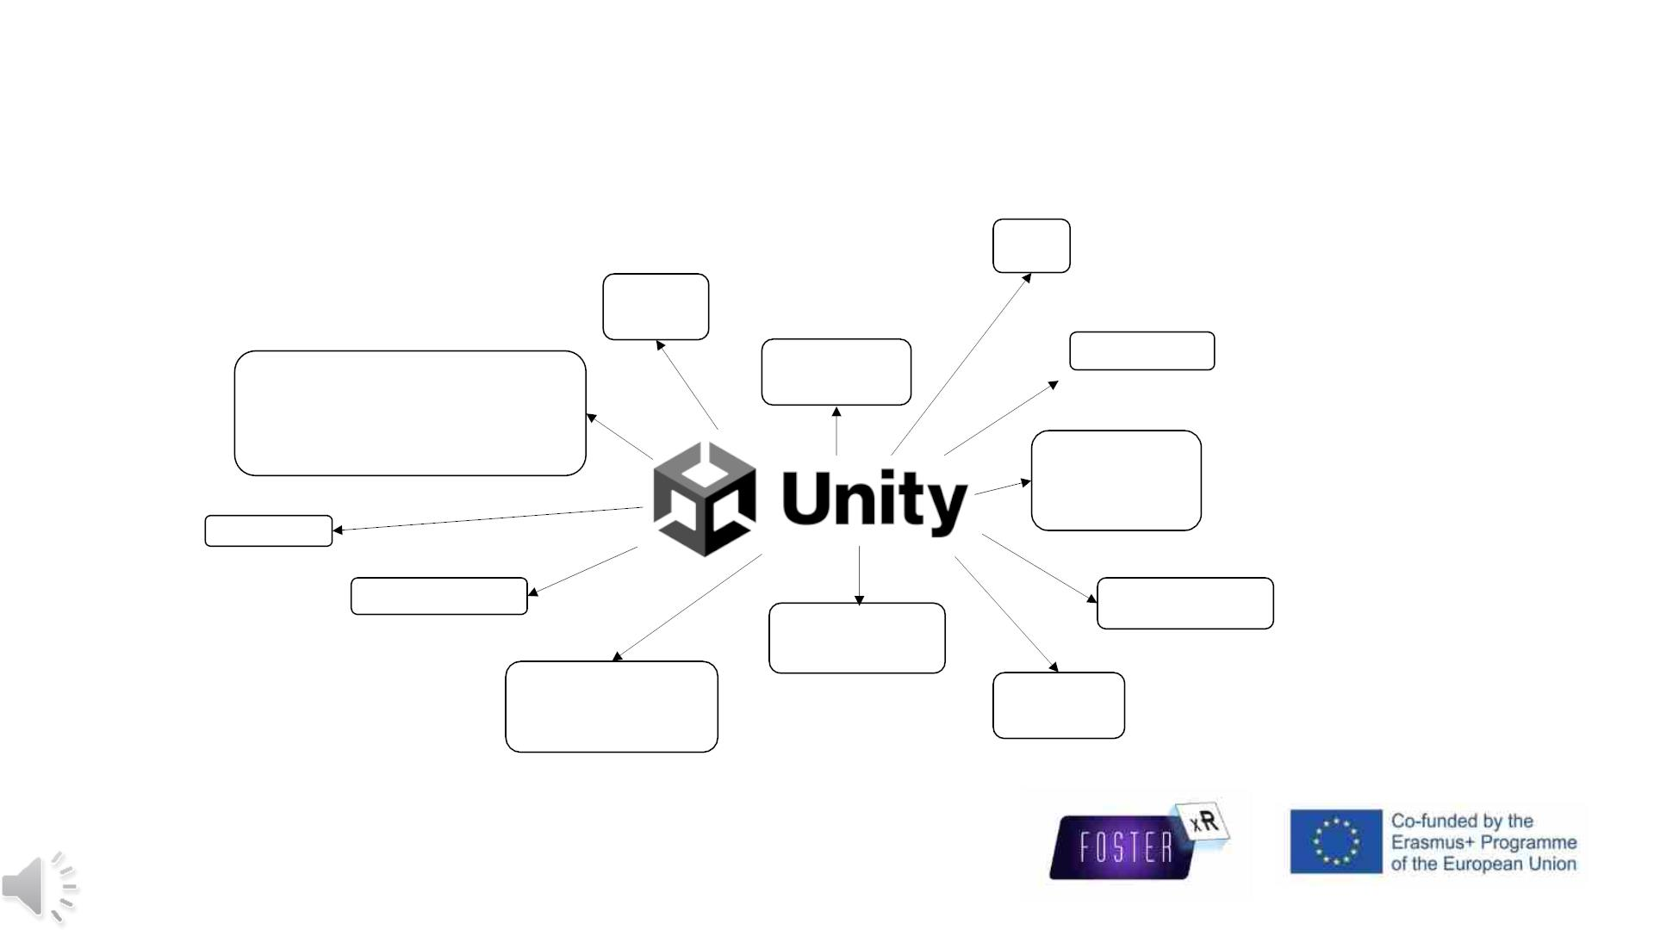
Methodology
2D
AR
3D
Designers
Engineering
VR
Architecture
Construction
Developers
Artists
Games
Films

Slide 8
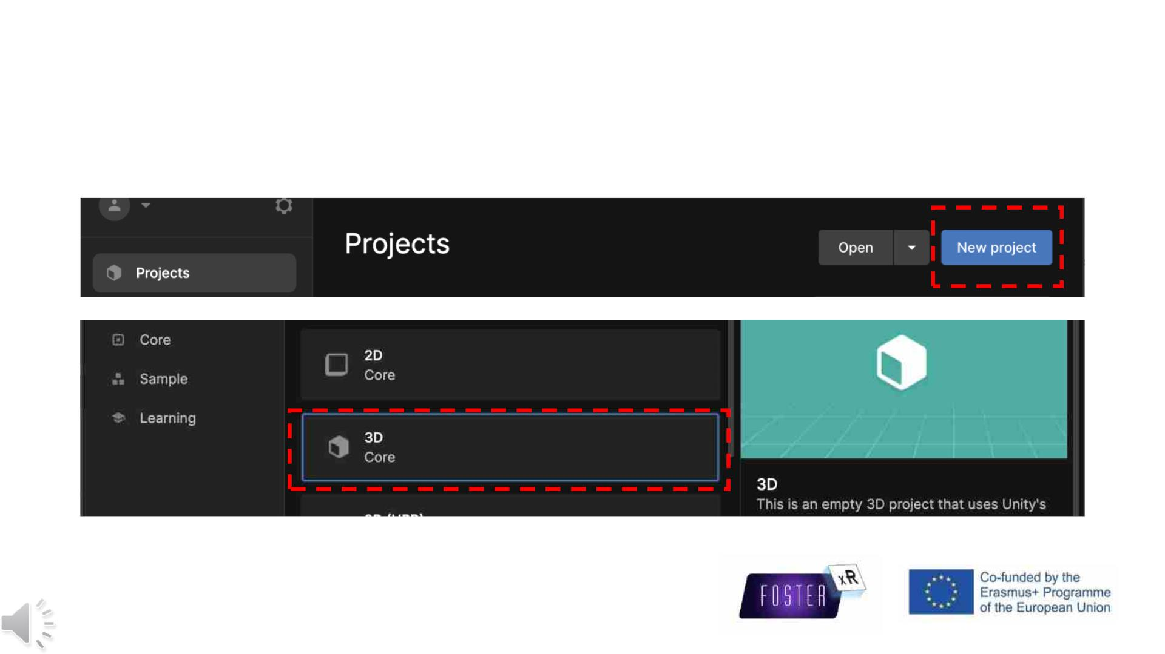
Methodology
Start up

Slide 9
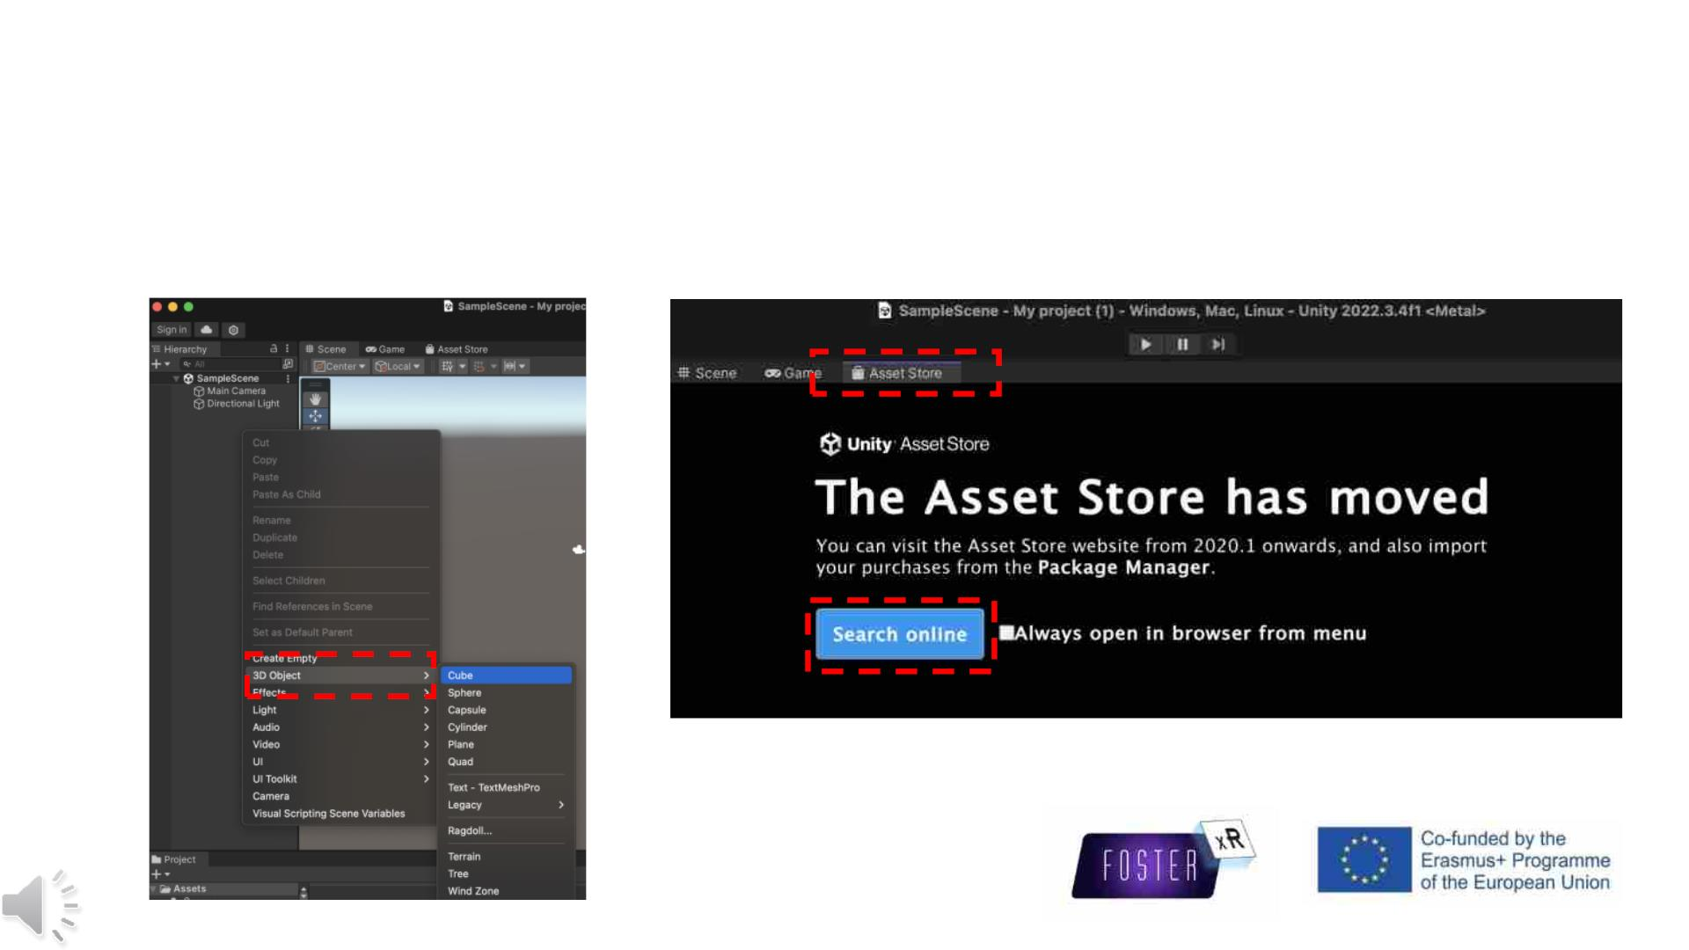
Methodology
Start up

Slide 10
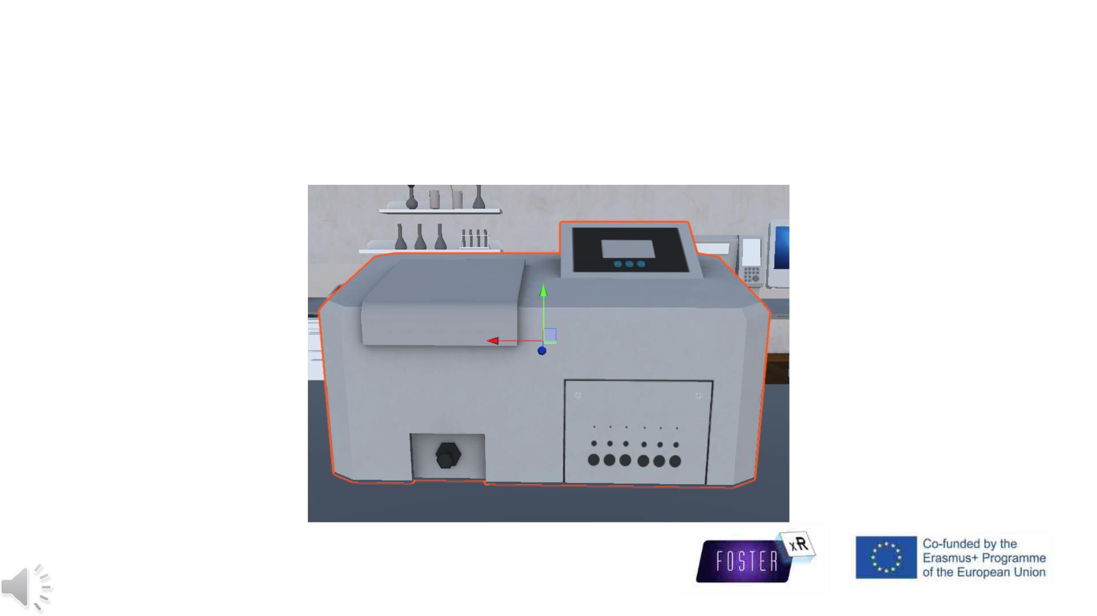
Methodology
Edit components

Slide 11
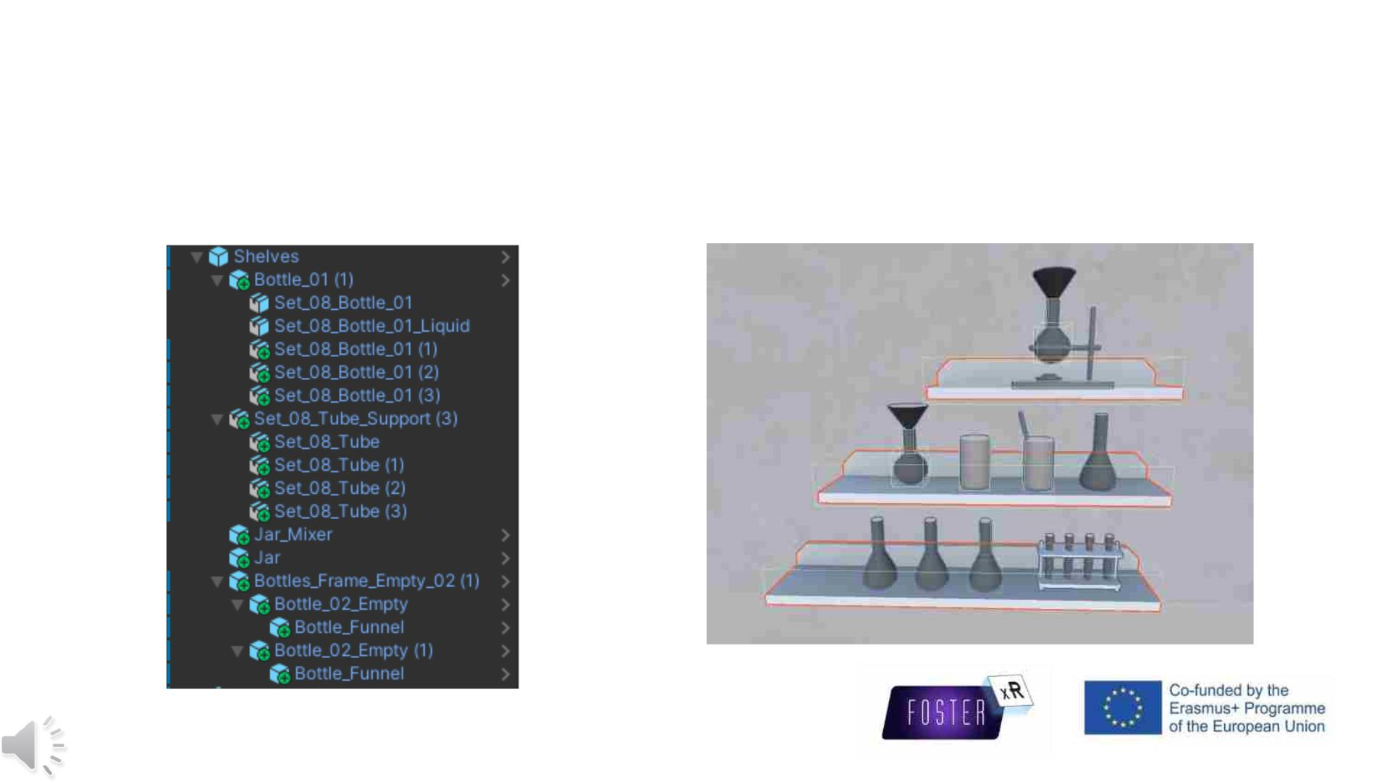
Methodology
Edit components

Slide 12
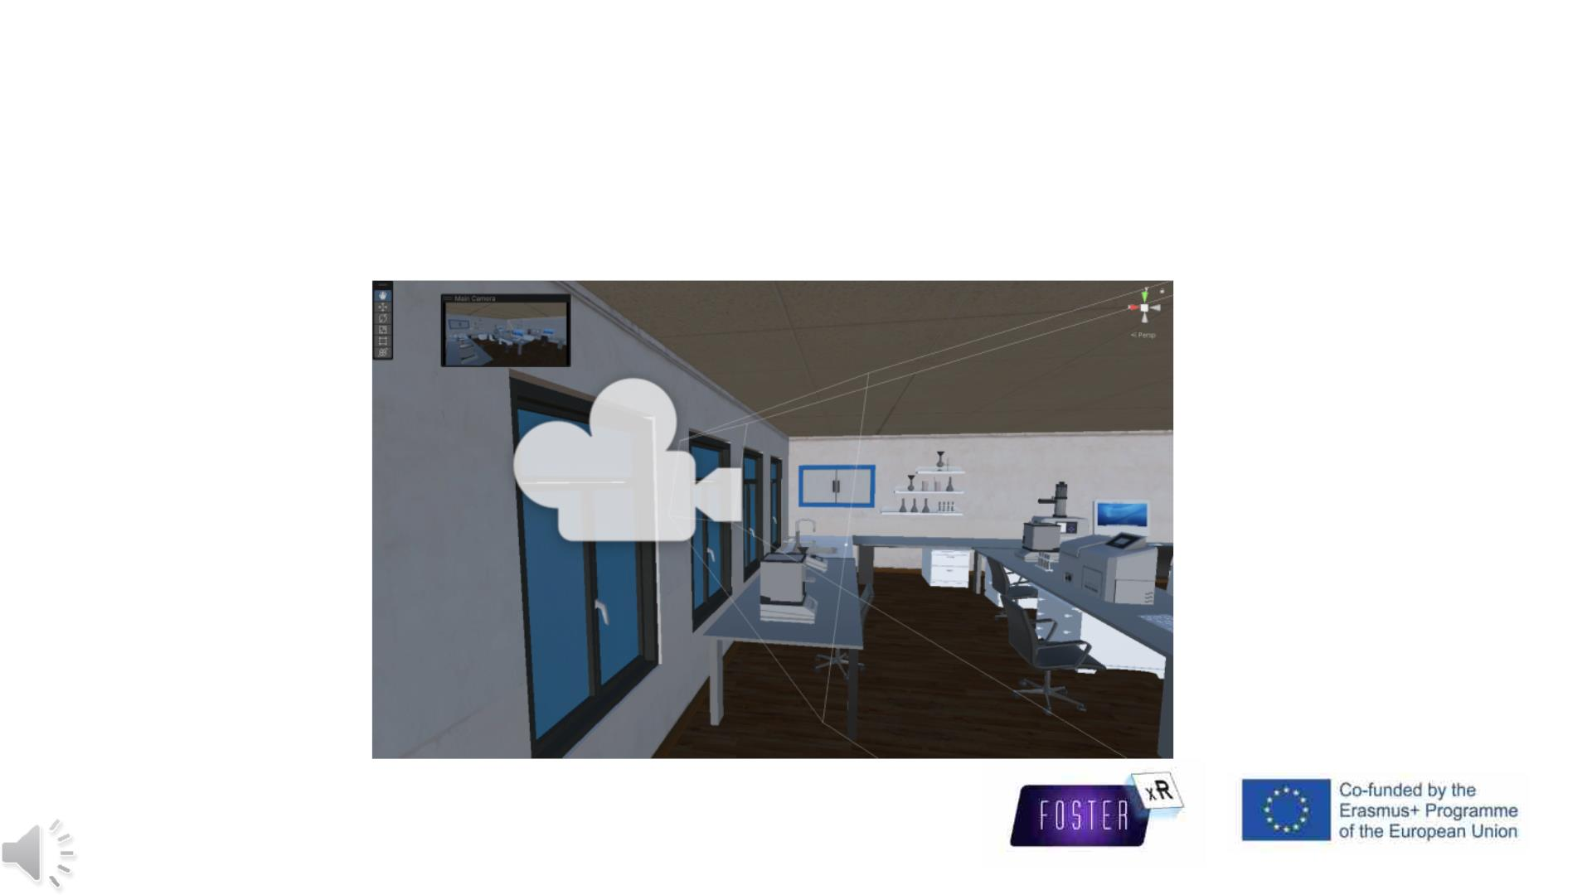
Methodology
Capture the scenes

Slide 13
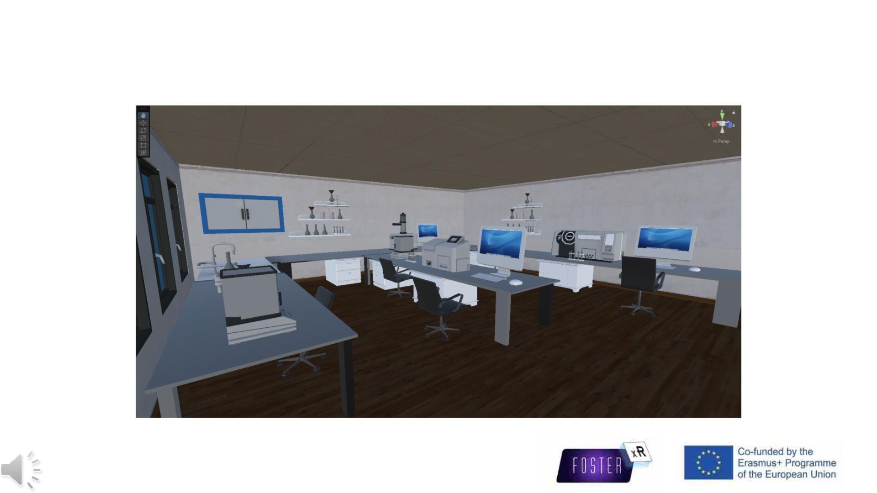
Results ---- 3D Model

Slide 14
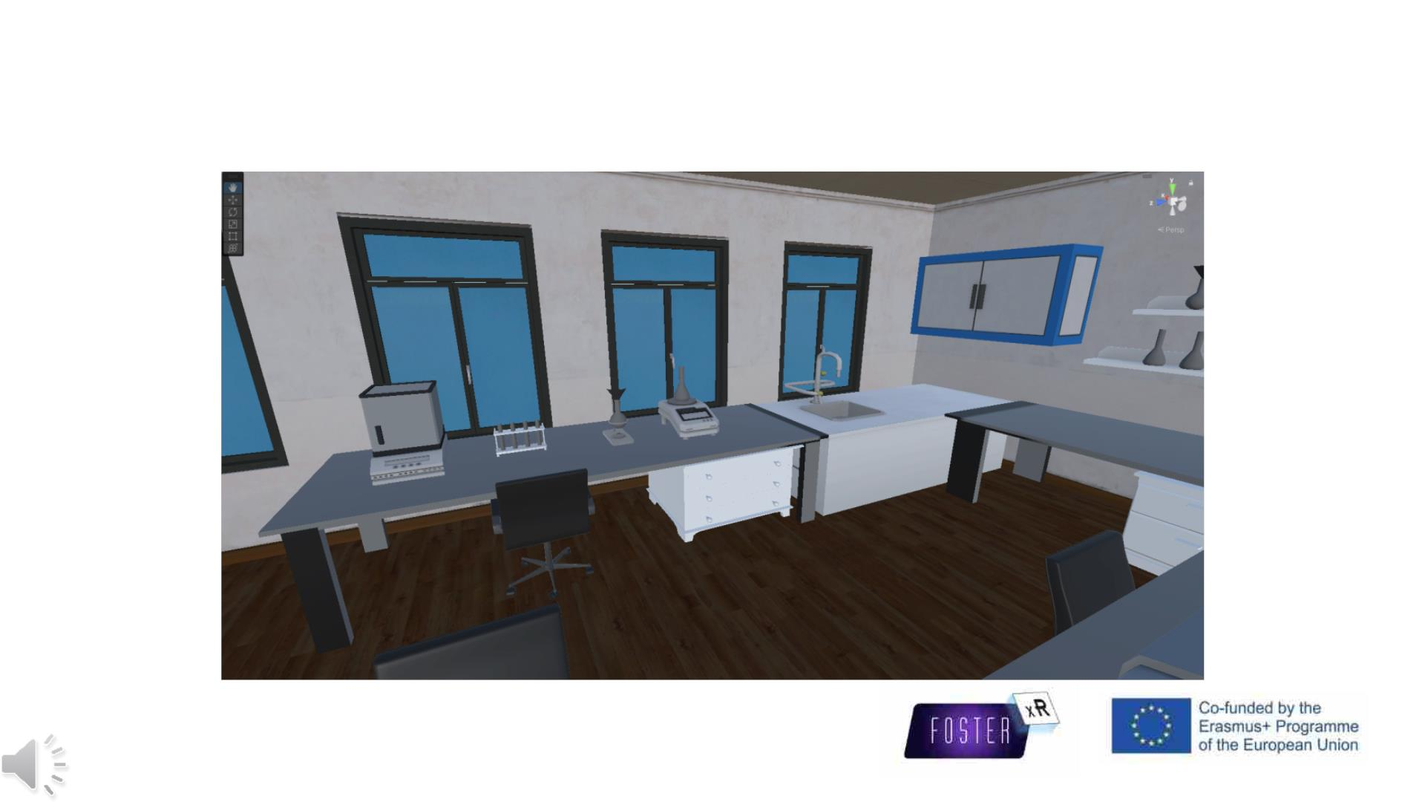
Results ---- 3D Model

Slide 15
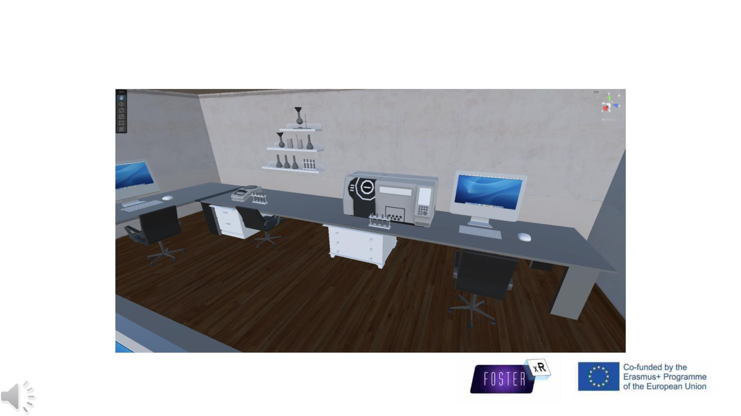
Results ---- 3D Model

Slide 16
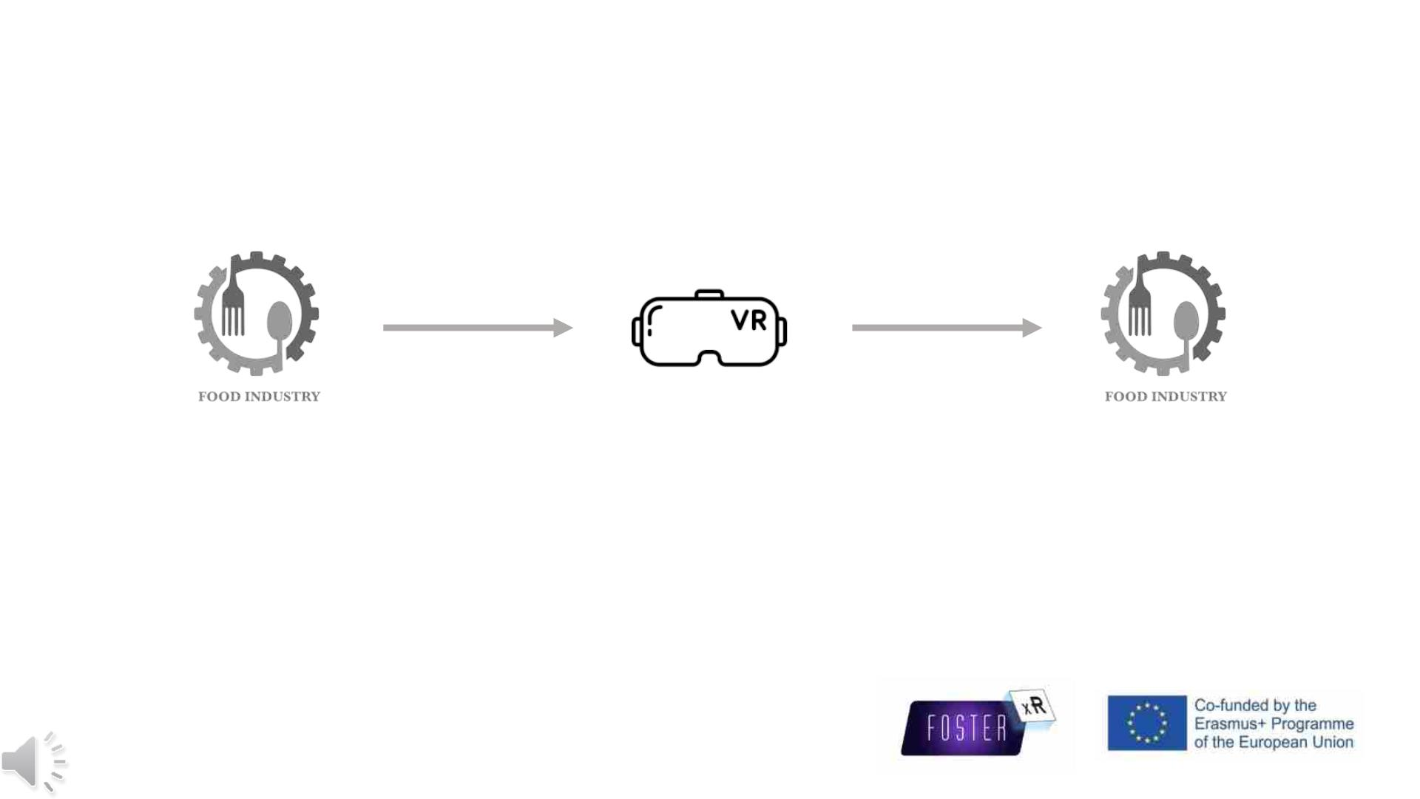
Conclusions
Modelling
Simulating
Applications
Commercialisation
From the reality, back to the reality

Slide 17
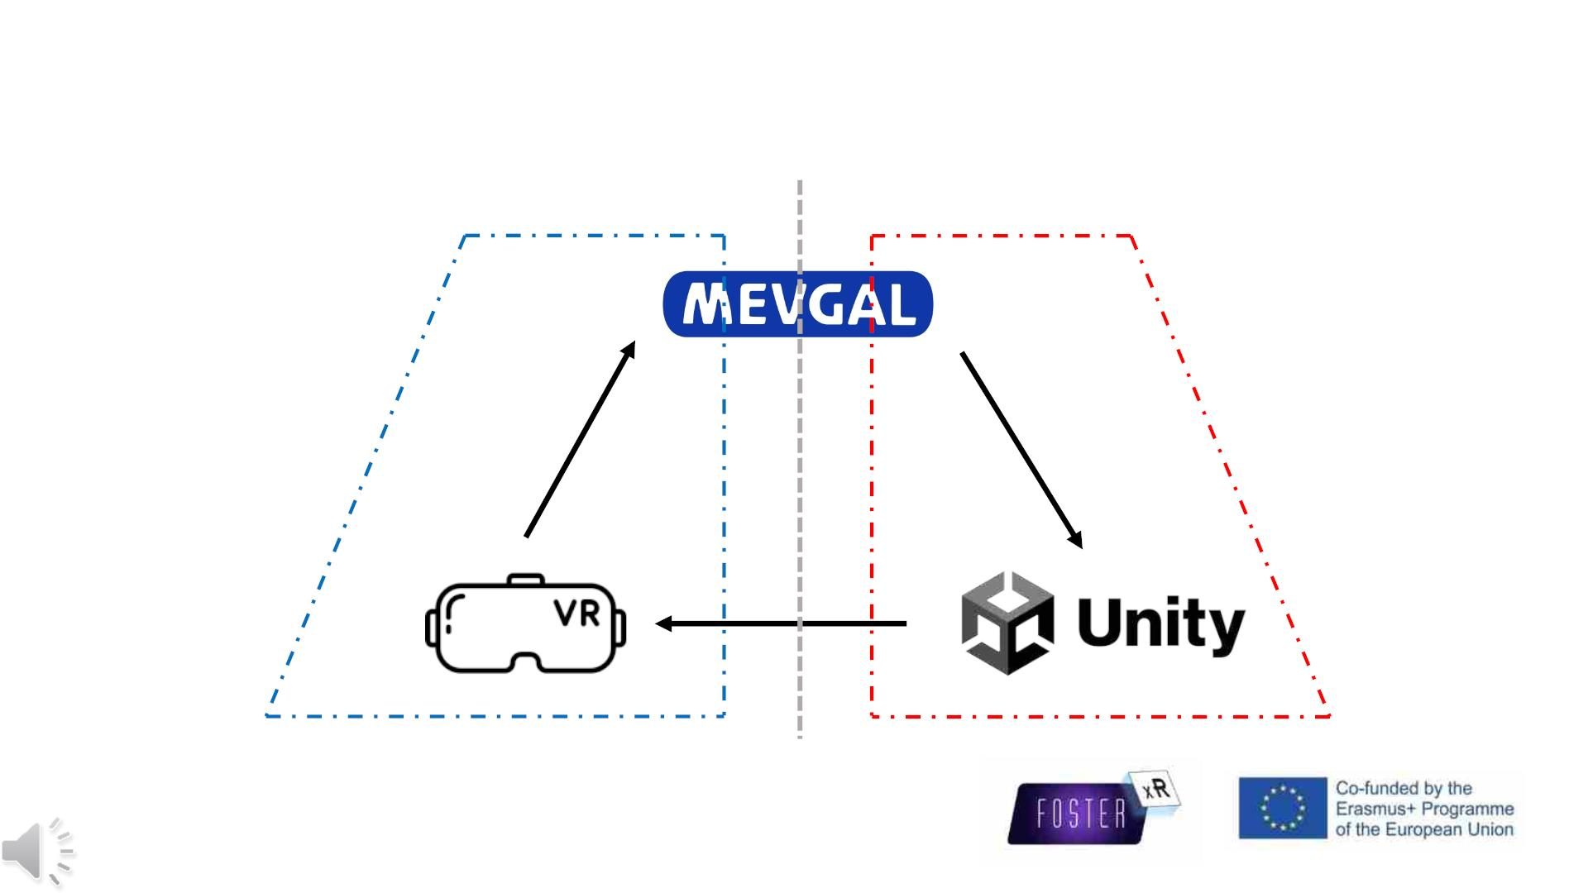
Conclusions
‘Downstream processing’
‘Upstream processing’
Applications
Modelling
Export
Optimisation

Slide 18
Conclusions
Outlooks of the applications of digital technologies in the food industry
• Training for new employees
• Regulate GMP or GLP
• Reduce potential risks
• Teaching
• Virtual lab/practices
• Virtual visit
• Advertising

Slide 19
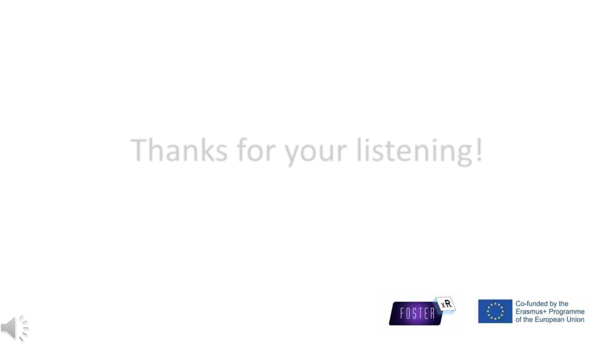
Thanks for your listening!

