Slide 1
Tips on note-taking
Agata Derkowska
Outreach Department
UM Library

Slide 2
Note-taking
When to take notes?
Listening to a lecture
Conducting an interview
Reading text-books and articles
Daily life situations

Slide 3
Note-taking
Writing or typing?

Slide 4

Note-taking: Writing
Studies show that writing things down may improve learning and retention of information.
Manual note-taking is more engaging and selective, which may cause more efficient studying.
Manual note-taking forces students to creatively generate content: paraphrasing, summarizing, mind-mapping etc…
It is slow.

Slide 5

Note-taking: Typing
Allows to write more.
Improves multitasking.
Using a laptop may be a distraction.
Notes taken by typing are often word for word, without processing and understanding (students write down everything that lecturer says). Mindless transcribing the content can lead to poor performance during exams.

Slide 6
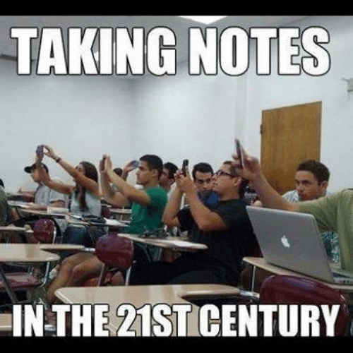

Slide 7
Note-taking
Good notes help you learn!
Each discipline may require different notes.
There are various note-taking methods that you can adapt to create your own style!

Slide 8
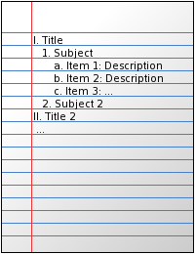
Note-taking: Outlining method
Prioritizing and writing information down in points.
Moving from main topic, to sub-topic/key-concept to details/descriptions/definitions/examples.
This method clearly structures notes.
It is easy to review.

Slide 9
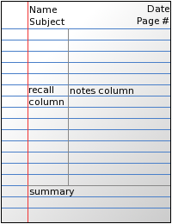
Note-taking: Cornell Method
Focuses on dividing page into two columns:
Recall/Cue column which includes headings, keywords, terminology or key concepts
Notes column which includes notes and more detailed description of terms in cue column
Summary section at the bottom of the page where you can write additional remarks and rephrase notes in your own words.

Slide 10
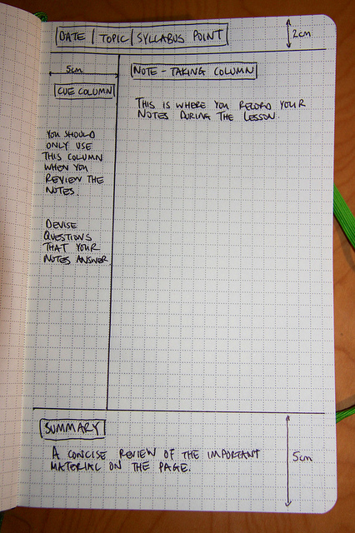
Note-taking: Cornell Method
During the lecture write down your notes in Notes column.
During the lecture, write down the main topic/question on top of the page.
At the end of the lecture, write down the summary at the bottom of the page.
After the lecture, review your notes and add keywords/headlines in Cue column.

Slide 11
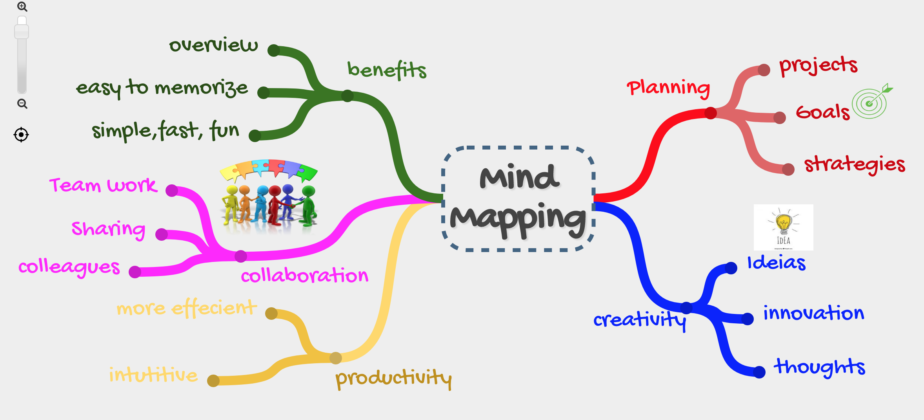
Note-taking: Mind maps
Mind maps are visual diagrams that help to organise information.
Mind maps are usually developed around a single concept with further ideas branching out.

Slide 12
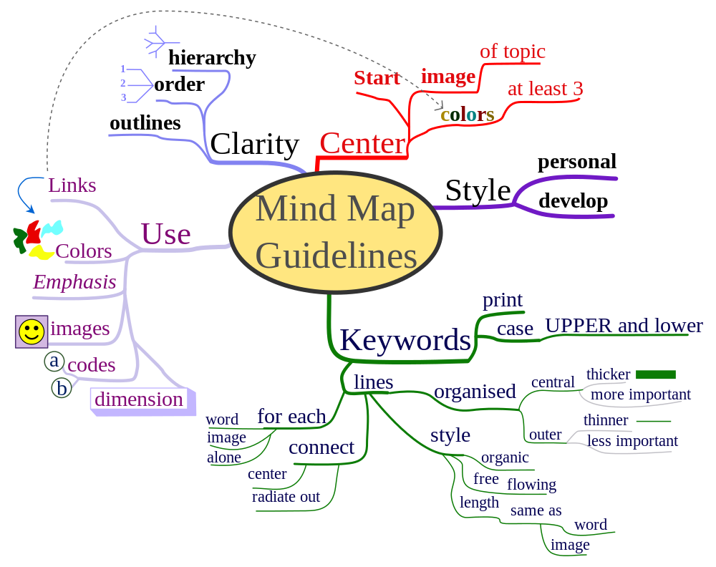
Note-taking: Mind maps
Write down main keyword/topic in the center of the page.
Create branches for other key concepts or ideas related to main topic.
Create subsequent branches to create hierarchical levels of information.

Slide 13
Note-taking: Tips
Colour-code your notes! Use different colours to highlight definitions, key-concepts and important information. Mark each module with a different colour so you can easily identify them!

Slide 14
Note-taking: Tips
Use abbreviations!
To note faster, use abbreviations. You can develop your own glossary, write it down in your note-book and always have it with you!

Slide 15
Note-taking: Tips
Record it!
If your lecturer talks too fast or you are worried that you might miss something important, consider recording the class or a presentation and take notes at home!

Slide 16
Note-taking: Tips
Rewrite your notes!
If your notes are chaotic, you may want to rewrite them. This will not only allow you to produce clean notes but also memorize the content.

Slide 17
Note-taking: Tips
Review your notes!
Always review your notes!
Take time to read through your notes shortly after the lecture and before the next one. This will help you remember new information!

Slide 18
Note-taking: References
Bristol, J. (2016). Cornell notes. Retrieved from http://jennybristol.com/2016/08/olio-16-cornell-notes/
GoodNotes. (2019). The best note-taking methods. Retrieved from https://medium.goodnotes.com/the-best-note-taking-methods-for-college-students-451f412e264e
Lundin, E. (2019). How to take better notes: The 6 best note-taking systems. Retrieved from https://collegeinfogeek.com/how-to-take-notes-in-college/
Mueller, P. A., & Oppenheimer, D. M. (2014). The pen is mightier than the keyboard: Advantages of longhand over laptop note taking. Psychological Science, 25(6), 1159-1168. doi:10.1177/0956797614524581
Sanders, C. (2018). 17 note-taking tips that will transform how you retain info. Retrieved from https://www.lifehack.org/794683/note-taking-tips
Schenkelberg, F. (2019). Mind mapping for non-linear thinking. Retrieved from https://accendoreliability.com/mind-mapping-non-linear-thinking/

Slide 19
Thank you for your attention! For further information you are welcome to contact us by calling on 2340 2541 or by e-mail library@um.edu.mt

