Slide 1

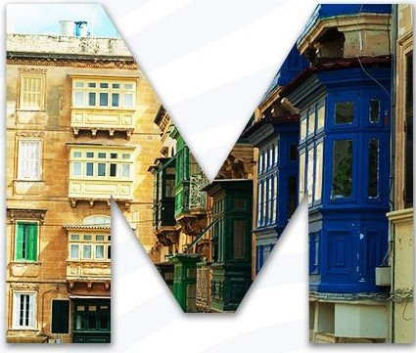

welcome to
Visitors Information Pack
info pack

Slide 2
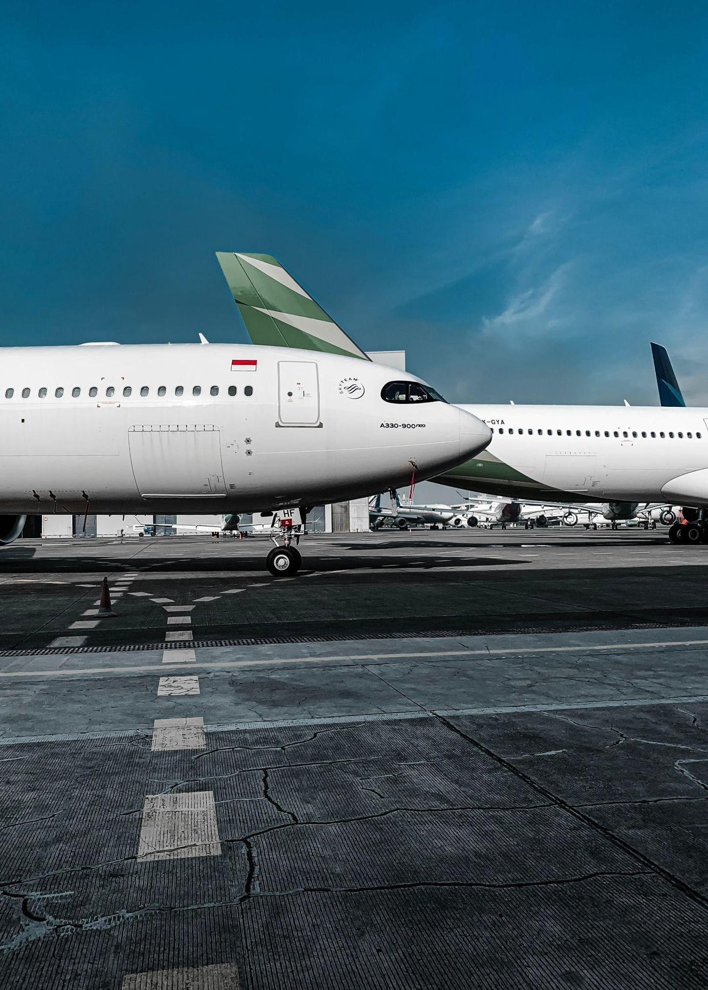









Arriving in Malta
Malta International Airport
Location
Taxi service is available 24 hours a day to any destination.
Recommended alternatives:
Public Bus Tallinja is accessible just outside the Airport Departures Hall.
Bus tickets can be purchased at the Airport 24/7 ticket machine or directly from the driver (accepts cash and card) .
Plan your journey

Slide 3
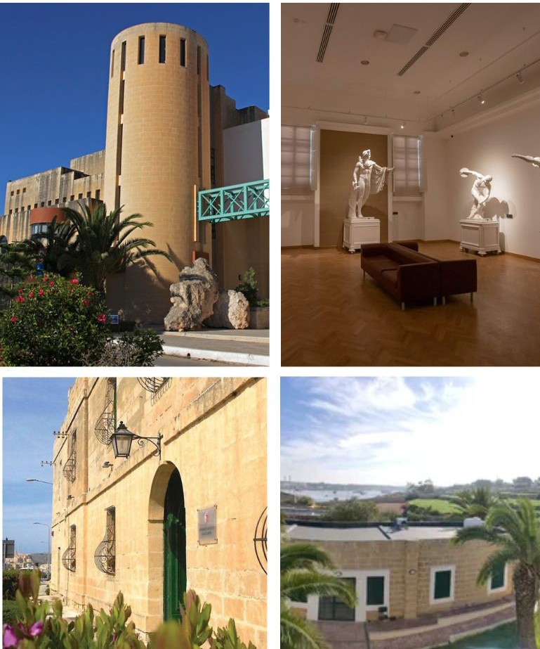

The University of Malta hosts some 11,500 students, including around 1,000 international students from 92 different countries and 450 visiting overseas students:
Main Campus Msida
Valletta Campus
UM Official Website
Today UM is composed of fourteen faculties, a number of interdisciplinary institutes and centres, three schools, a junior college and four campuses.
Gozo Campus
Marsaxlokk Campus

Slide 4
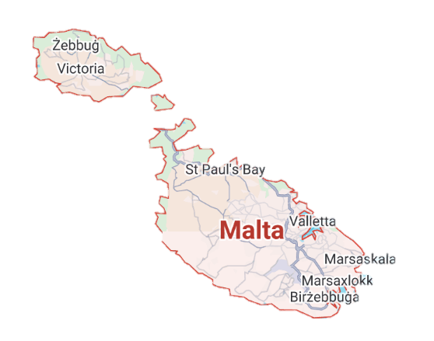
📍 University of Malta – Msida Campus (Main Campus) Address: University of Malta, Msida MSD 2080, Malta Coordinates: 35.9021° N, 14.4828° E 📍 University of Malta – Valletta Campus Address: St Paul’s Street, Valletta VLT 1216, Malta Coordinates: 35.8984° N, 14.5140° E

Slide 5

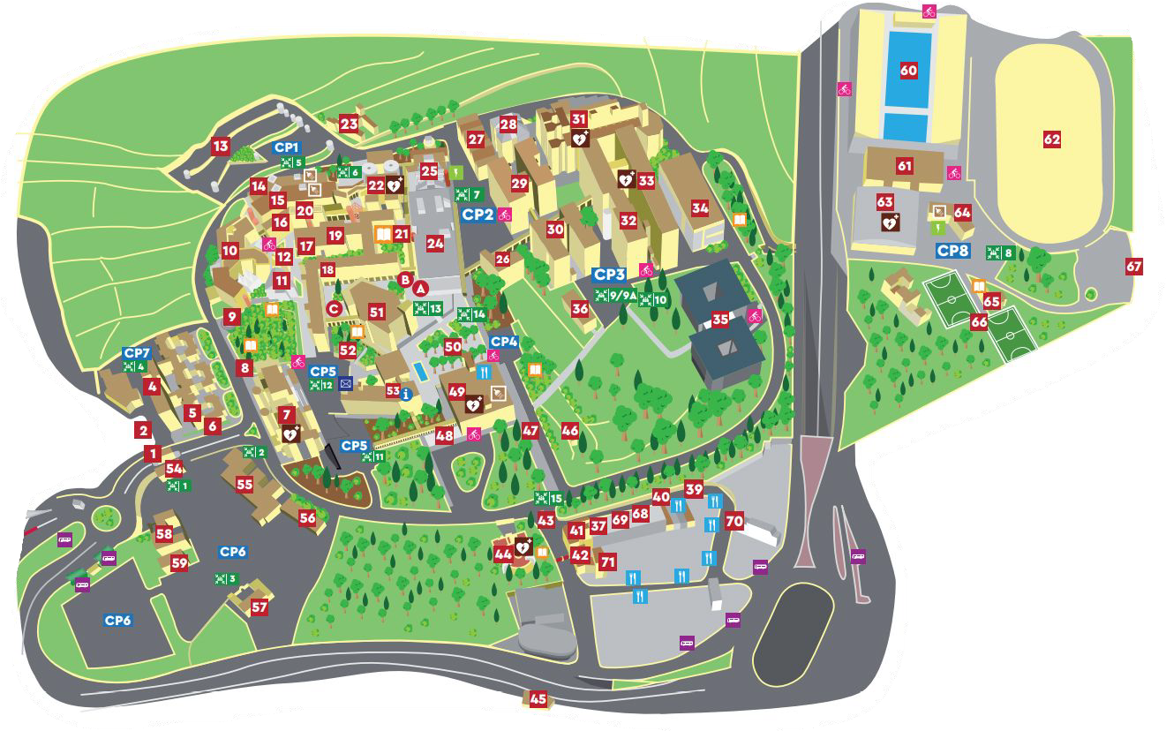





Main Campus Msida
Corporate Research and Knowledge Transfer Oﬃce
Project Support Oﬃce
Research Support Services Directive
Bus stop
“Universita”
Map detail

Slide 6
Suggested accommodation + rates
Near Valletta Campus (within walking distance)
Name of the hotel | Street Name | Contact email address | Rates for accommodation
Luciano Valletta Boutique Accommodation | Merchants Street, Valletta | info@vallettaboutique.com | Standard double room with street view @ €180 p/n on b&b basis Standard double indoor room @ €120 p/n on b&b basis
Luciano Al Porto Boutique Accommodation | St Ursula Street, Valletta | info@vallettaboutique.com | Double room with street view @ €160 p/n on b&b basis Double room with Grand Harbour view @ €200 p/n on b&b basis
Savynomad Harbour Residences | Battery Street, Valletta | info@savynomad.com | Cave 24: luxury double bed house with private Jacuzzi Spa Cave & Harbour views @ €290 p/n Port 531 & Oasis 22: luxury double bed house with harbour views @ €170 p/n Coast 52: superior double bed house with harbour views @ €180 p/n Salt 54: standard double bed studio in pedestrian street @ €122 p/n Cove 532: standard single studio apartment with harbour views @ €123 p/n
Osborne Hotel/ 3★ | 50 South Street, Valletta | reservations@osbornehotel.com | Standard room for sole use @ €160 p/n on b&b basis Standard room for double use @ €180 p/n on b&b basis
Palazzo Consiglia Boutique Hotel/ 4★ | 102 St Ursula Street, Valletta | reservations@ikcollection.com | Superior room @ €220 p/n on b&b basis
Use "Connecting Research Managers/University of Malta” as reference when booking one of the above accommodations

Slide 7
Suggested accommodation + rates
Near Valletta Campus (within walking distance)
Name of the hotel | Street Name | Contact email address | Rates for accommodation
San Karlu Boutique Hotel/ 4★ | 28 Triq San Karlu, Valletta | shyzler@allelon.com.mt | Standard room @ €205 p/n on b&b basis
La Falconeria Boutique Hotel/ 4★ | 62 Melita Street, Valletta | shyzler@allelon.com.mt | Standard room @ €205 p/n on b&b basis
The Gomerino Boutique Hotel/ 4★ | St Paul Street, Valletta | shyzler@allelon.com.mt | Standard room @ €230 p/n on b&b basis
Palais Le Brun Boutique Hotel/ 4★ | Old Bakery Street, Valletta | shyzler@allelon.com.mt | Standard room @ €230 p/n on b&b basis
The Saint John Boutique Hotel/ 4★ | Merchants Street, Valletta | sylvain.azzopardi@axhotelsmalta.com; gabriel.cortis@axhotelsmalta.com | Comfort room @ €155 p/n on b&b basis
Grand Hotel Excelsior/ 5★ | Great Siege Road, Floriana | nerissa.camilleri@excelsior.com.mt | Deluxe room for sole use @ €157 p/n on b&b basis Deluxe room for double use @ €177 p/n on b&b basis
Use "Connecting Research Managers/University of Malta” as reference when booking one of the above accommodations

Slide 8
Suggested accommodation + rates
Near Msida Campus
Name of the hotel | Street Name | Contact email address | Rates for accommodation
Holiday Inn Express/ 3★ | St George’s Bay, St Julians | rita.rizzo@ihg.com | Standard room @ €77 p/n on b&b basis
IKYK Hotel/ 3★ | 15 Wilġa Street, St Julians | reservations@ikcollection.com | Economy room @ €50 p/n on b&b basis Superior room with balcony @ €55 p/n on b&b basis
115 The Strand Hotel/ 3★ | The Strand, Gzira | sales@theneucollective.com | Superior room @ €85 p/n on b&b basis
Verdi St George’s Bay Marina Hotel/ 4★ | St George’s Bay, St Julians | maria.camilleri@corinthia.com | Superior seaview room for sole use @ €105 p/n on b&b basis Superior seaview room for double use @ €130 p/n on b&b basis
Verdi Gzira Promenade Hotel/ 4★ | The Strand, Gzira | maria.camilleri@corinthia.com | Deluxe room for sole use @ €100 p/n on b&b basis Deluxe room for double use @ €125 p/n on b&b basis
Vivaldi by Verdi Hotels/ 4★ | Dragonara Road, St Julians | maria.camilleri@corinthia.com | Superior cozy room for sole use @ €115 p/n on b&b basis Superior cozy room for double use @ €140 p/n on b&b basis
Urban Valley Resort/ 4★ | Triq Wied Għollieqa, San Ġwann | corporatesales@urbanvalleyresort.com; brian.calleja@urbanvalleyresort.com | Superior room for sole use @ €80 p/n on b&b basis Superior room for double use @ €90 p/n on b&b basis
Holm Boutique Hotel/ 4★ | Sqaq Lapsi Land, St Julians | reservations@ikcollection.com | Superior room @ €90 p/n on b&b basis Executive suite with kitchenette & outdoor spa @ €145 p/n on b&b basis
Use "Connecting Research Managers/University of Malta” as reference when booking one of the above accommodations

Slide 9
Suggested accommodation + rates
Near Msida Campus
Name of the hotel | Street Name | Contact email address | Rates for accommodation
Waterfront Hotel/ 4★ | Triq ix-Xatt, Sliema | cnaudi@water.mizzi.com.mt | Single room @ €120 p/n on b&b basis Double room @ €130 p/n on b&b basis
The Victoria Hotel/ 4★ | Gorg Borg Olivier Street, Sliema | gabriel.cortis@axhotelsmalta.com; sylvain.azzopardi@axhotelsmalta.com | Classic room @ €100 p/n on b&b basis
Kennedy Nova Hotel/ 4★ | The Strand, Gzira | sales@kennedynova.com | Single Standard room @ €51 p/n on b&b basis Double Standard room @ €60 p/n on b&b basis
Hyatt Centric Hotel/ 5★ | Triq Santu Wistin, St Julians | ruth.micallef@hyatt.com | Standard room for sole use @ €160 p/n on b&b basis
Corinthia Hotel/ 5★ | St George’s Bay, St Julians | maria.camilleri@corinthia.com | Superior room for sole use @ €120 p/n on b&b basis Superior room for double use @ €145 p/n on b&b basis
Radisson Blu Resort/ 5★ | St George’s Bay, St Julians | maria.camilleri@corinthia.com | Standard room for sole use @ €135 p/n on b&b basis Standard room for double use @ €160 p/n on b&b basis
The Palace Hotel/ 5★ | High Street, Sliema | gabriel.cortis@axhotelsmalta.com; sylvain.azzopardi@axhotelsmalta.com | Comfort room @ €140 p/n on b&b basis
Marriott Hotel/ 5★ | Main Street, St Julians | Mariella.BorgBondin@maltamarriott.com | Superior room with courtyard view for sole use @ €165 p/n on b&b basis Superior room with courtyard view for double use @ €189 p/n on b&b basis
Intercontinental Hotel/ 5★ | St George’s Bay, St Julians | rita.rizzo@ihg.com | Classic room @ €136 p/n on b&b basis
Voco Malta Hotel/ 5★ | St George’s Bay, St Julians | rita.rizzo@ihg.com | Standard room @ €141 p/n on b&b basis
Use "Connecting Research Managers/University of Malta” as reference when booking one of the above accommodations

Slide 10

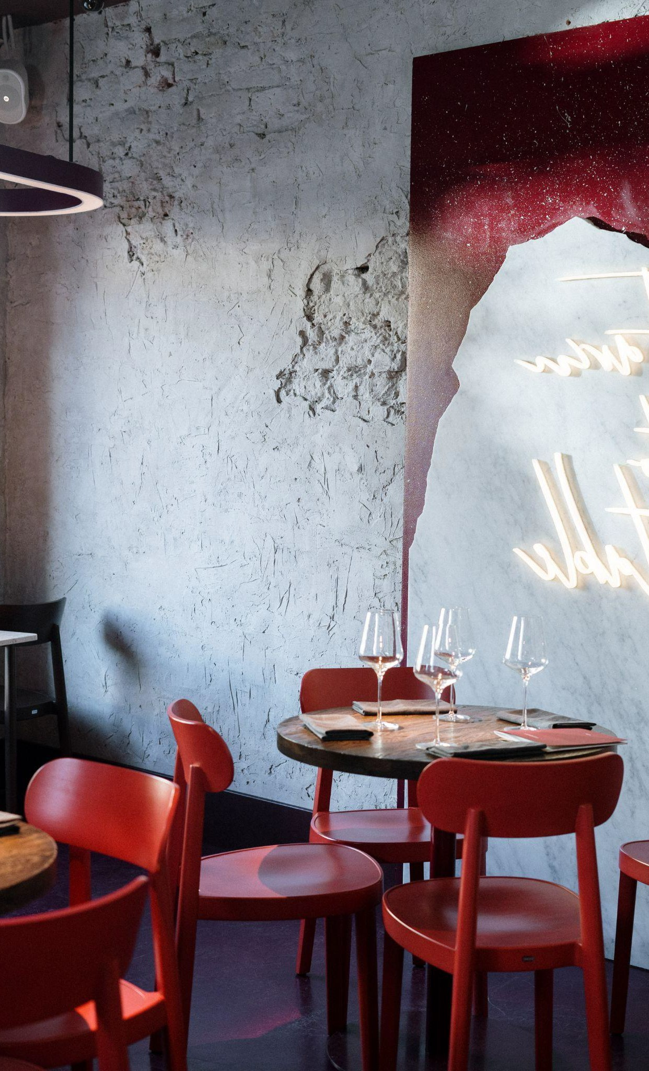





Recommendations
Food & Drink
Breakfast
Busy Bee Msida , Maltese Cafe Bella Sicilia , Cafe, Sicilian, Southern Italy
Maltese Cuisine
Ta' Kris Restaurant - Sliema
Il-Merill - Sliema Gululu - St Julians
Other Recommendations
Zero Sei Malta Italian Roman Food Valletta
Capo Crudo - Valletta
Lovin Malta 2023 Food Recommendations

Slide 11
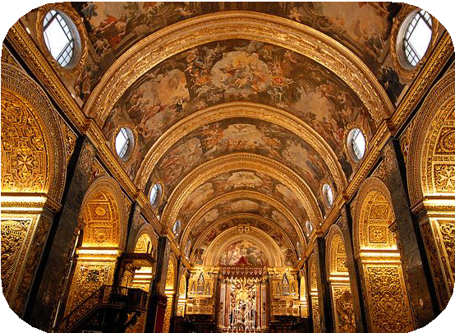
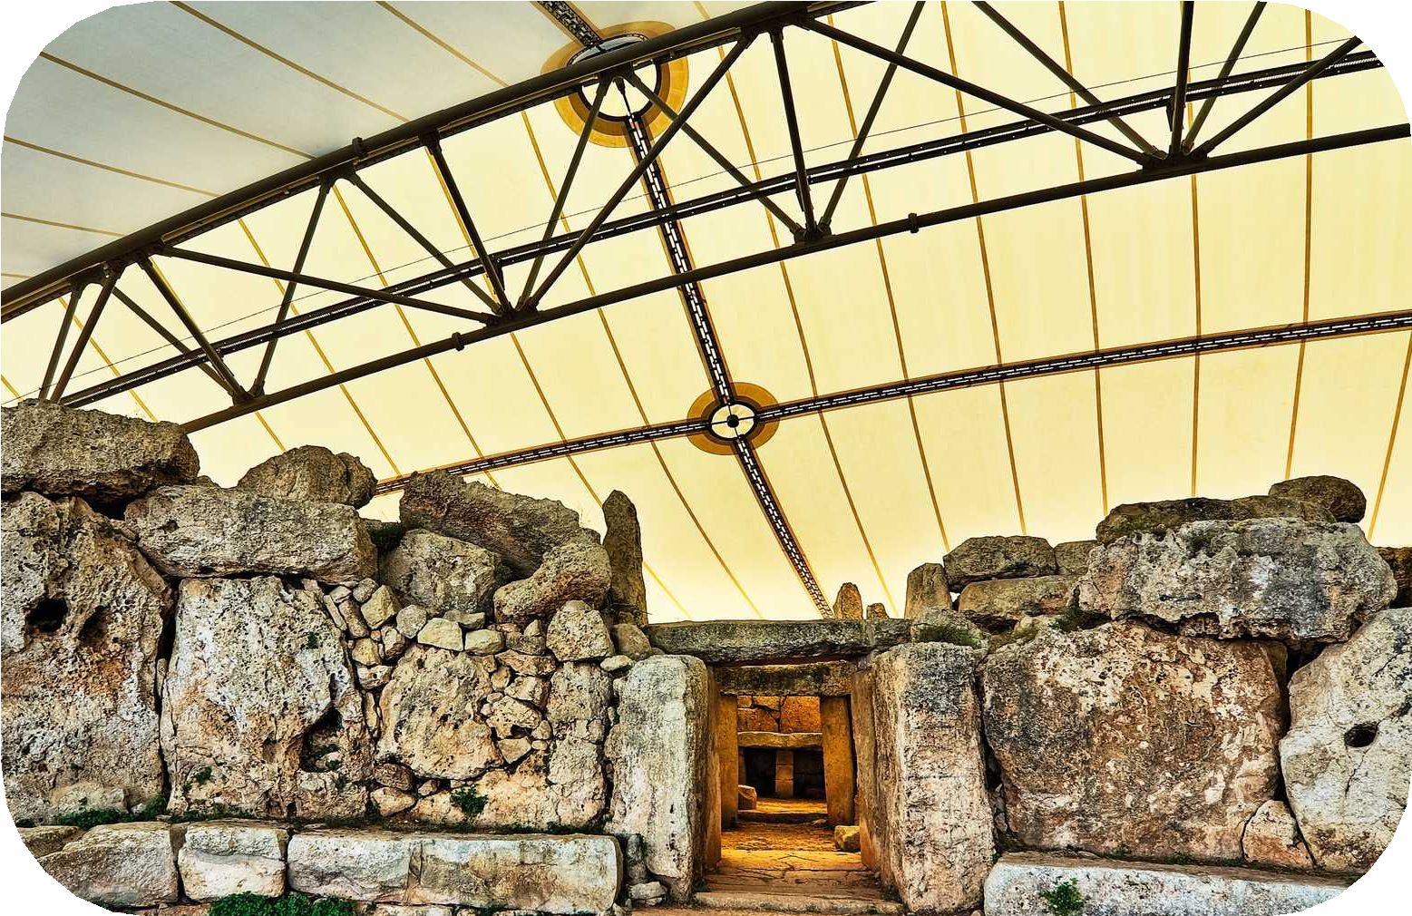
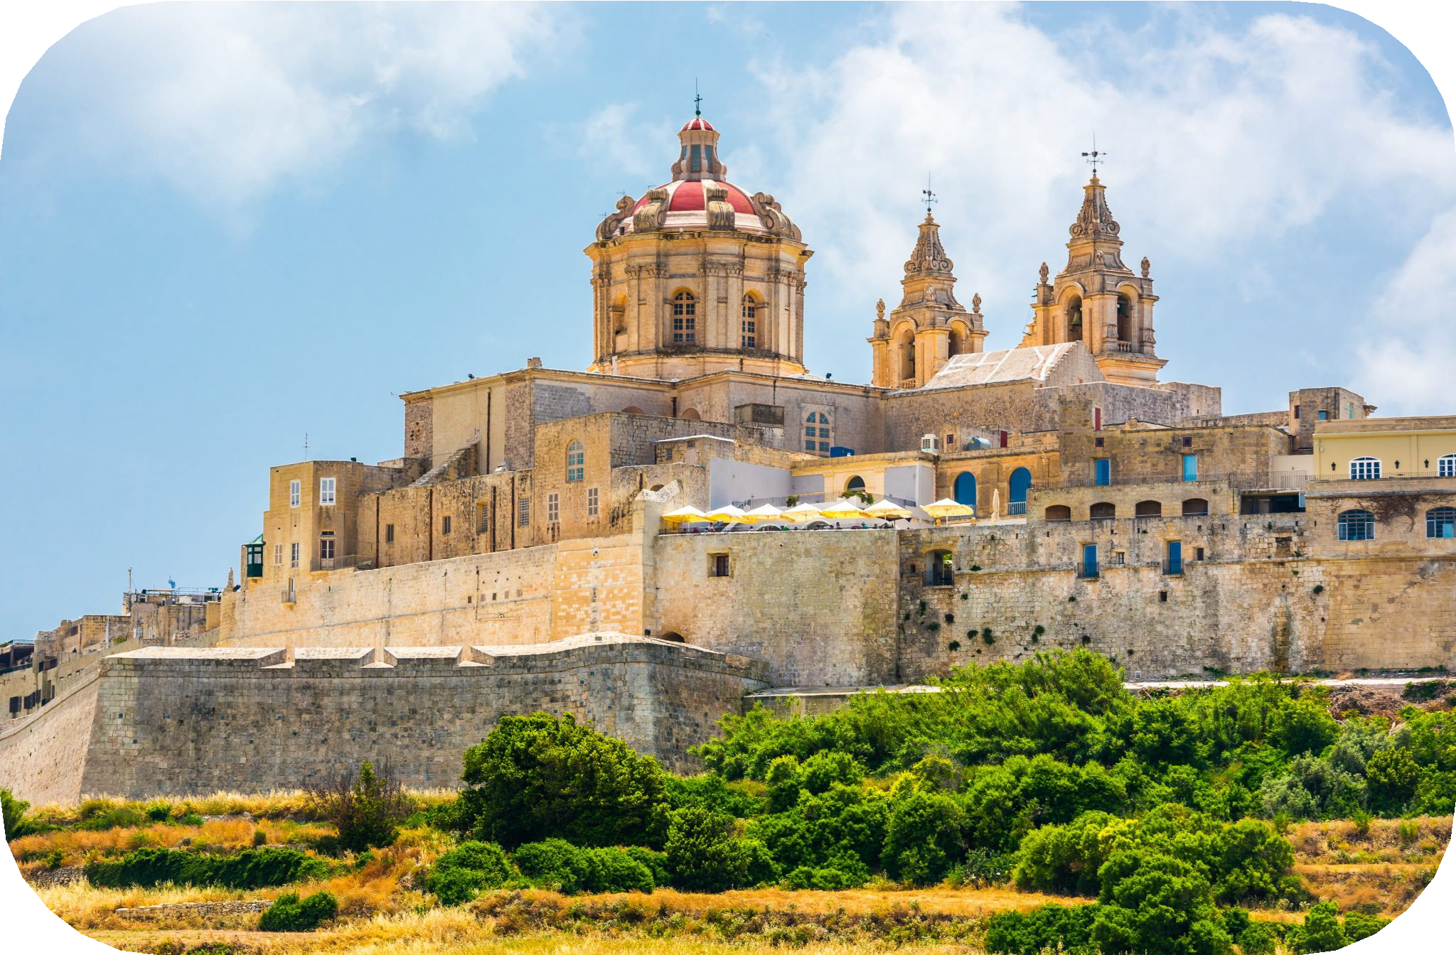


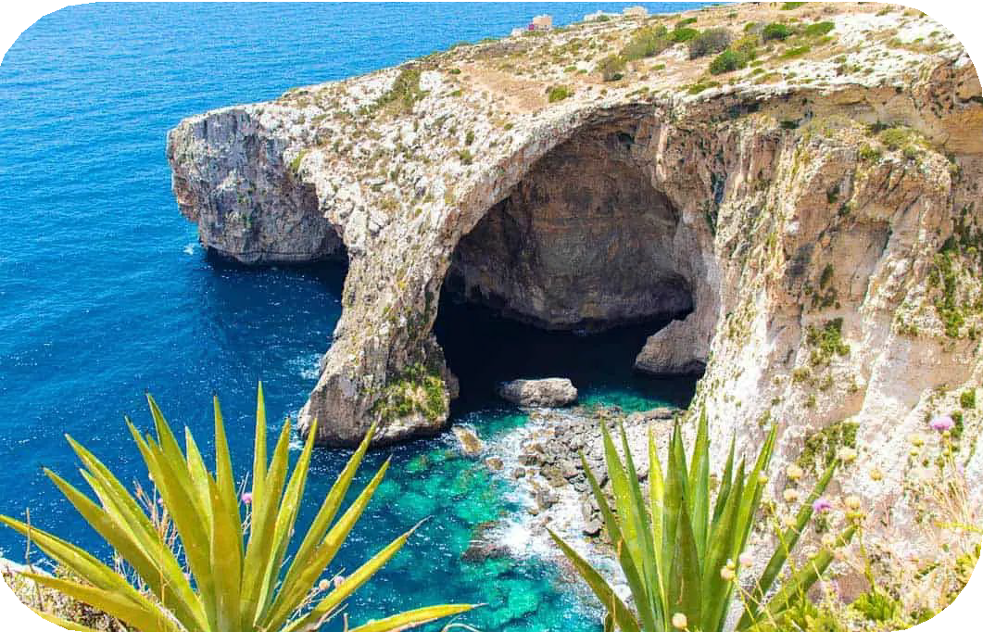
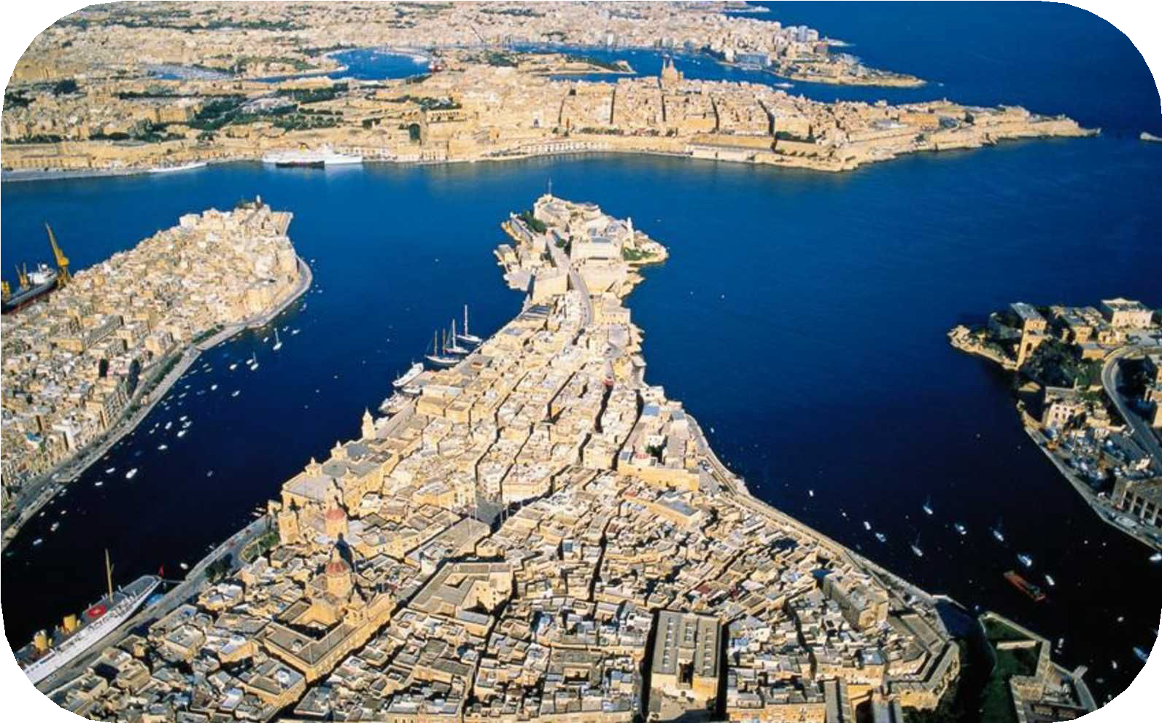
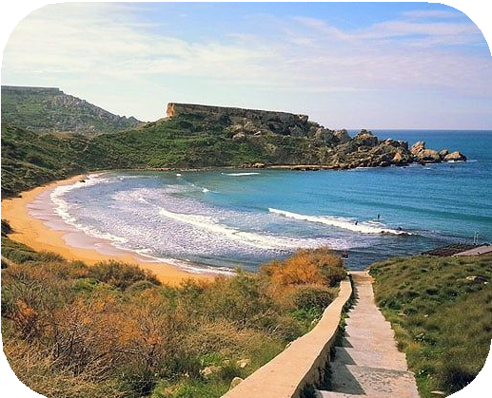

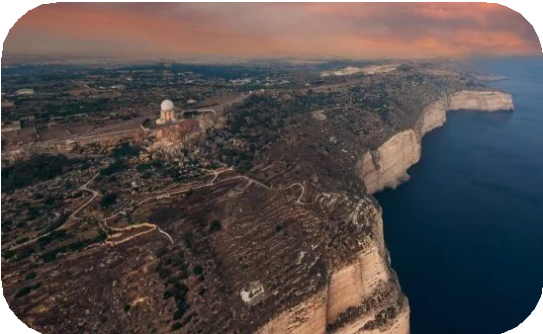
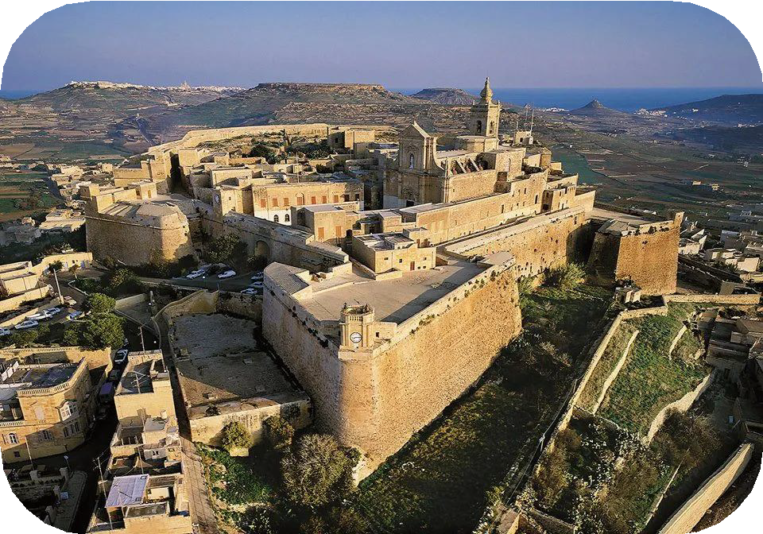
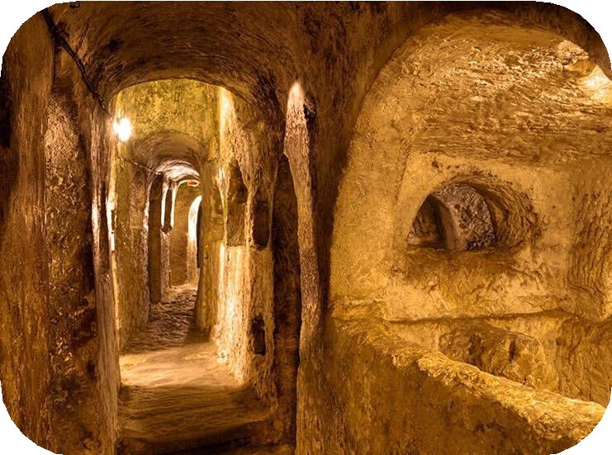

Places of interest
Saint John’s Cathedral
City of Valletta
Ħaġar Qim
Mdina Old City
Temples
Qrendi
Mdina
Blue Grotto
Zurrieq
Three Cities
Birgu
Riviera Beach
Għajn Tuffieħa
Cittadella
Victoria, Gozo
St Paul’s Catacombs
Rabat
Dingli Cliffs
Dingli

Slide 12









Useful Information
Telephone Preﬁx
+356
Emergency Number 112
Malta Health Centres
https://www.pharmacy.mt/health-centres/
Plug:
Type G (UK)
More to explore:
Visit Malta https://www.visitmalta.com/en/
Lovin Malta https://lovinmalta.com/
Malta Public Transport
https://www.publictransport.com.mt/
Valletta Ferry Service
(Sliema - Valletta - 3 cities)
https://vallettaferryservices.com/
Gozo Fast Ferry (Valletta - Mgarr)
https://gozofastferry.com/
Gozo Channel (Mgarr - Gozo)
https://www.gozochannel.com/
If you have any questions, please contact us at: staffweek.rssd@um.edu.mt
staffweek.rssd@um.edu.mt

