Slide 1




FYP 2024-25
Information Session & Q&A
Faculty of
ICT
Academic Year
2024-25
Department of
Computer Information Systems
Last Updated
01-Oct-2024

Slide 2

CB and SD Boards of Studies
The Boards of Studies are responsible for academic matters related to the respective degree programme.
Board of Studies for Computing and Business Peter Xuereb peter.xuereb@um.edu.mt
Board of Studies for Software Development John Abela john.abela@um.edu.mt

Slide 3
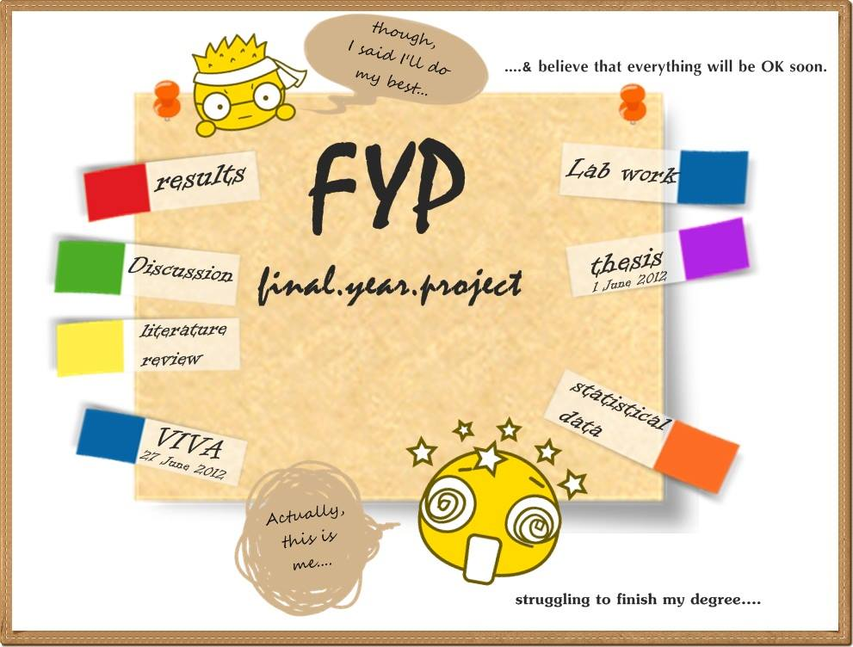
Topics
FYP Stages
FREC Form
Form B
Progress Report
Submission & Viva Voce
Guidelines and Addendum
FYP Document Format
Review Paper (CB only)
Student Requests
Other Matters

Slide 4
FYP Stages
Stage 1 – Background and Literature Review
This will contain a background section (an explanation of the main ideas, concepts, techniques, and theory used in your work) and a literature review (a comprehensive survey of the main academic works in the area).
Stage 2 – The Artefact
Various chapters that describe the methodology, design, implementation, testing, experimentation, evaluation, and conclusions (including future work) of the work related to the chosen area and artefact. Also includes the Introduction chapter.
Both stages are marked separately.
The FYP document submitted in May includes both stages.

Slide 5
FREC (Faculty Research Ethics Committee) Form
Due to GDPR requirements all students must fill in, and submit, a designated FREC form.
This is not an option.
The deadline is set by the Faculty and is usually mid-November.
https://www.um.edu.mt/ict/students/facultyresearchethicscommittee

Slide 6
FYP Form B
The FYP proposal is submitted by filling in Form B and sending the form by email to your principal supervisor.
Do not exceed the 300-word limit.
Your principal supervisor will then email the completed form to CIS Admin to indicate his/her endorsement.
The deadline for the submission of Form B is Friday 11th October 2024 by end of day.
You can submit before if you like.
Form B is not an assessed deliverable.

Slide 7
Progress Report (January)
The progress report should contain the sections below and should normally not exceed 2 pages.
a description of the project,
introduction to the area,
scope and motivation behind the project,
brief overview of the main literature in the area,
aims and objectives to be achieved in the FYP,
a list of deliverables including the artefact,
methods to be used (methodology) and the evaluation strategy of expected results, and
a work plan identifying subtasks/dependencies and a timeline (or Gantt chart).
The Progress Report is due in January and is sent by email to the supervisor only.
You will receive explicit instructions and a template in due course.

Slide 8
Submission and Viva Voce
Draft submission of the FYP document to the supervisor/s is on Friday 9th May 2025 by email.
Submission of the FYP document and declarations is Friday 30th May 2025. Submission of PDF and Binaries through the VLE.
Do not forget to check a draft of the document for similarity on Turnitin.
It is expected that the viva voce examination will be in persona this academic year.
Viva voce is 20 minutes presentation and 10 minutes Q&A.
You might be asked to demo your work.
Please refer to the FYP Calendar for 2024-25 since dates may change.
Dates might
Change!

Slide 9
Guidelines and Addendum
The Faculty of ICT’s FYP Guidelines are available online on the FICT portal. Download and read the guidelines.
The Department of CIS also issues an Addendum to the above guidelines. The Addendum is an Appendix in the Faculty of ICT FYP Guidelines document.
Note that the SD and CB Addendums take precedence over the Faculty FYP Guidelines.

Slide 10
FYP Document Format
Please note that the page limit for the FYP document for the 2024-25 Academic Year is 40 pages.
This applies to both SD and CB.
The 40 page limit is only for the main content (Chapter 1 to last Chapter).
There is no word limit.

Slide 11
FYP Review Paper (CB Only)
Computing and Business FYP Students must also write, and submit, a Review Paper.
Details are in the Guidelines and in the Addendum.

Slide 12
Student Requests
Requests for Change of FYP Titles or for FYP Extensions should be submitted no later than the Monday 3rd March 2025.
The designated forms must be used.
This is so as to give enough time for the request to be considered by the Board of Studies, Faculty Board, and then University Senate before the FYP submission date.
Requests submitted after the 3rd March 2025 may still be considered but the risk in then solely on the student.
Do not forget about the long abstract for the FICT exhibition.
Dates might
Change!

Slide 13
Undergraduate Regulations
The Undergraduate Regulations are available at: Undergraduate Regulations, 2019 (um.edu.mt)

Slide 14
Undergraduate Regulations
In the case of a Dissertation Study-Unit, the Board shall appoint a supervisor for each student, provided that if required a co-supervisor may also be appointed.
A supervisor shall not be related to a student by consanguinity or by affinity to the third degree inclusive or have a dual relationship with the student, as defined in the document approved by Senate entitled Consanguinity / Affinity / Dual Relationship Policy in relation to Examiners/Supervisors and Students.
Supervisors shall meet students regularly to review progress. Meetings may be substituted by other means of communication.
Supervisors are not responsible for proof-reading Dissertations. Neither is it their responsibility to ensure that Dissertations do not contain plagiarised parts.
If plagiarism is detected by a supervisor in drafts or in the final version of a dissertation prior to formal submission, the supervisor shall use discretion as to whether to reprimand the student and demand corrective action or to report the matter to the Assessment Disciplinary Board, depending on the gravity of the offence

Slide 15
Undergraduate Regulations
The supervisor, or the supervisory team when a co-supervisor is appointed, shall be responsible for providing guidance to students under their care in the following areas:
assisting students to select and elaborate a research problem and to formulate a written proposal for their Dissertation
offering ideas and providing guidance and encouragement on the planning and progress of research, submission of the dissertation, and publication of results;
providing or arranging instruction in research methodology, including use of information technology;
guiding students in acquiring and improving appropriate generic skills, including written and oral communication, numeracy, decision-taking and organisational and management skills;
ensuring that the students are aware of the manner in which research results are reported and that they understand the implications of plagiarism and other unbecoming academic practices;
advise the student on the use of plagiarism detection software that is approved by the University; and
any other matters which require the attention of the Board or Senate.

Slide 16
Other Matters
Remember that the Poster is a deliverable that is obligatory.
The Poster will be used for the FICT FYP Exhibition.
There are various examples of posters in the corridors of Block A, Level 1.
Faculty templates are available for the FYP document and the Review Paper (Word and LaTeX).
The Faculty also provides a PowerPoint template for the poster.
Again, remember the Exhibition Abstract.

Slide 17
Other Matters
When you encounter problems that cannot be resolved with your principal supervisor, do not leave it too late to escalate to the Chair of your degree programme.
IMPORTANT – If you change the topic or even the research direction you might have to resubmit the FREC form.

Slide 18



